Slide 1
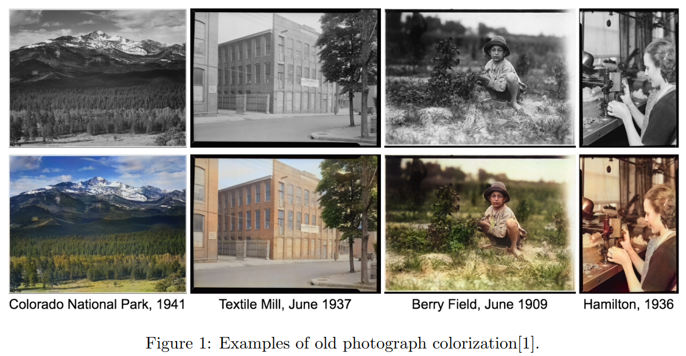
Image Colorization

Slide 2
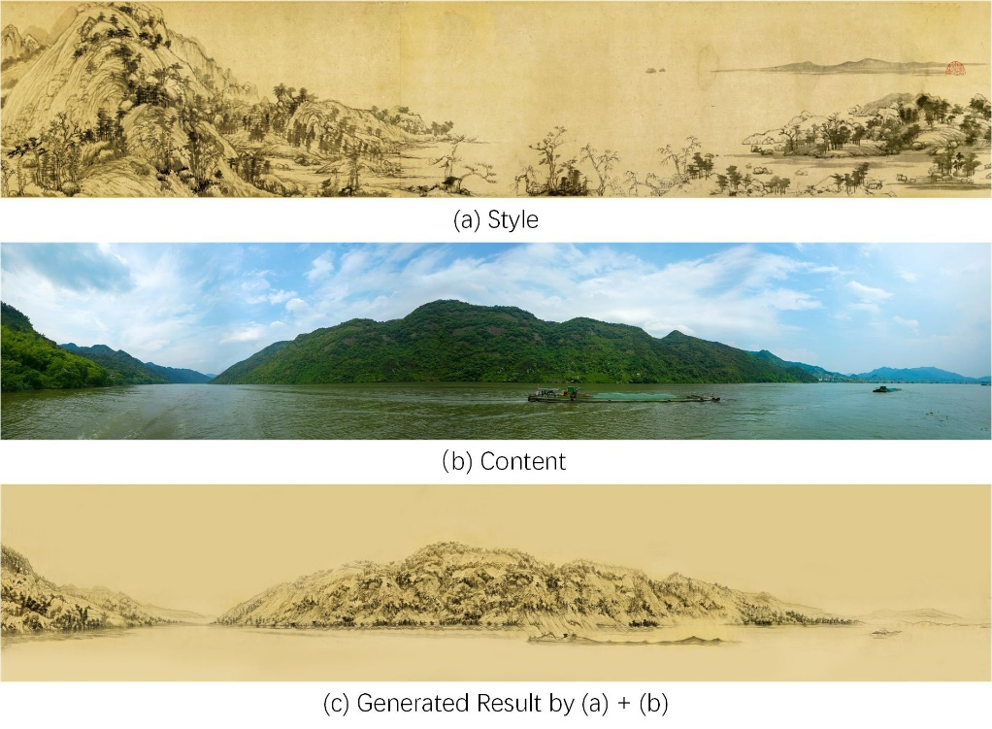
Chinese Painting Style Transfer

Slide 3
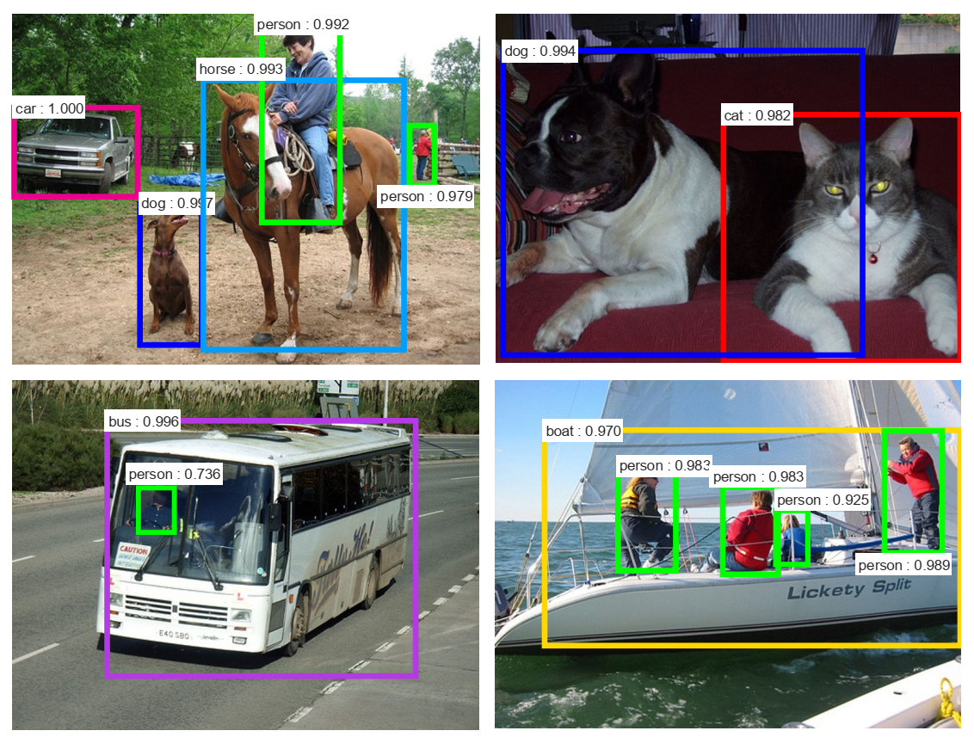
Object Detection

Slide 4
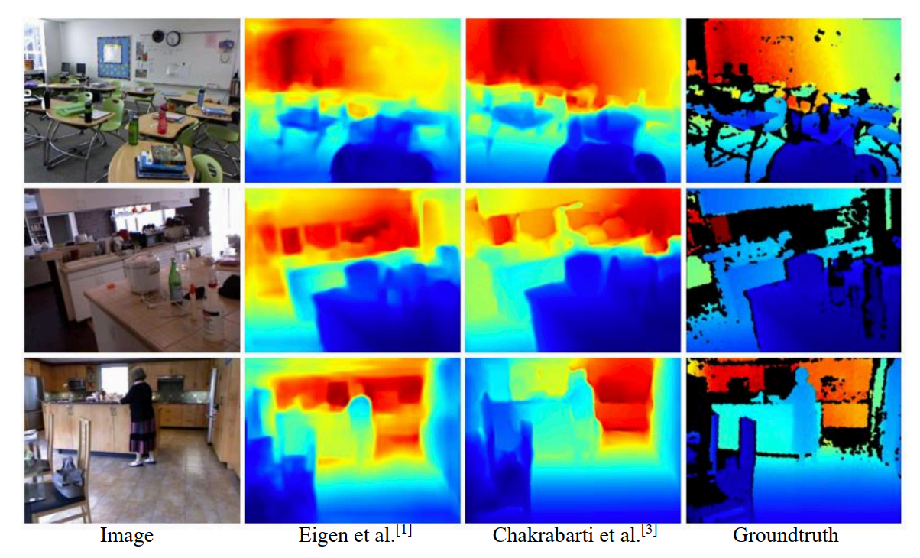
Monocular Depth Estimation

Slide 5
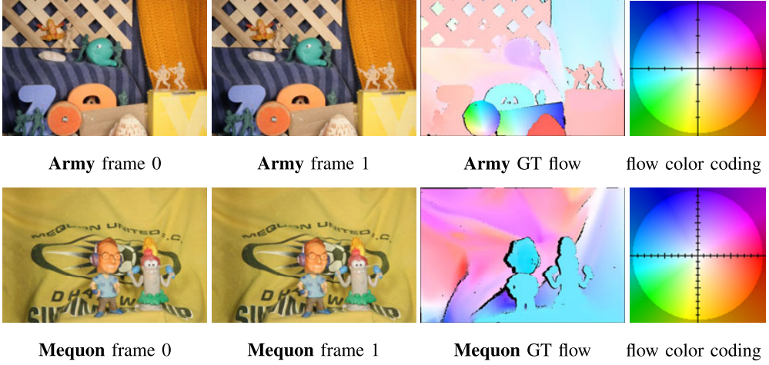
Optical Flow Estimation

Slide 6
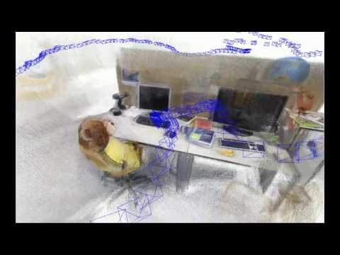
Vision-based SLAM

Slide 7
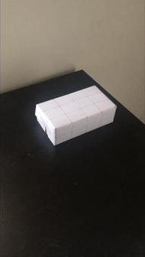
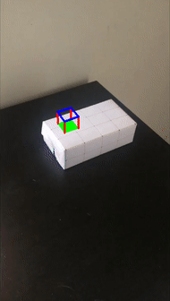
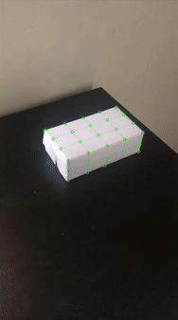
Easy Augmented Reality
input
result
tracked points
Credit: Alex Efros

Slide 8
Requirement (video and oral)
For 1 min video (DDL: Dec 27, 2025)
  To be clear and easy to follow
  Show your basic idea
  Preliminary results
  Not necessarily to be complete, but should include core contribution
For 8 min oral presentation (Date: Dec 30, 2025)
  To be clear and easy to follow
  To include as many contents in the final report

Slide 9
Requirement (final report, Jan 18, 2026)
Please refer to the enclosed template file or the overleaf project at：
  https://www.overleaf.com/read/rdtytdngpdhk
Be 6-8 pages (exclude reference)
Be like a paper (refer to CVPR papers)
  Clear contributions
  Self-contained contents
  Reasonable results
  Comparison with SOTA
  Well presented Figures (more than 3 figures) and tables

Slide 10
Grading
Two mini programming projects:
  Homework1（15%）
  Homework2（15%）
Final: Team work, ≤ 3， Weight：1.0、0.9、0.8
  Final Project Presentation （20%），for each team
    1 min video presentation 10%
    Select ~20 teams for Oral
      give the talk (5%)
      score from audiences（5%）
  Final Project（50%）
    Documentation and code by DDL
    Deadline：At the end of Winter Semester 2026 [Jan 18, 2026】

