Slide 1
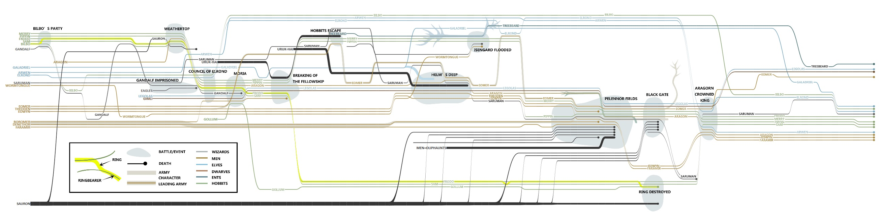
StoryFlow: Tracking the Evolution of Stories
Shixia Liu, Yingcai Wu, Enxun Wei, Mengchen Liu, Yang Liu
Microsoft Research Asia

Slide 2
Outline
Introduction
Optimization Framework
StoryFlow Layout
Interactive Exploration
Experiments
Conclusion

Slide 3
Outline
Introduction
Optimization Framework
StoryFlow Layout
Interactive Exploration
Experiments
Conclusion

Slide 4
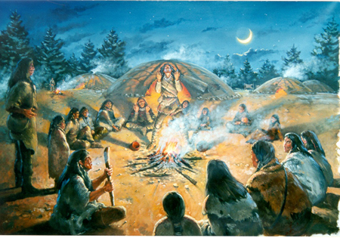
Storytelling

Slide 5
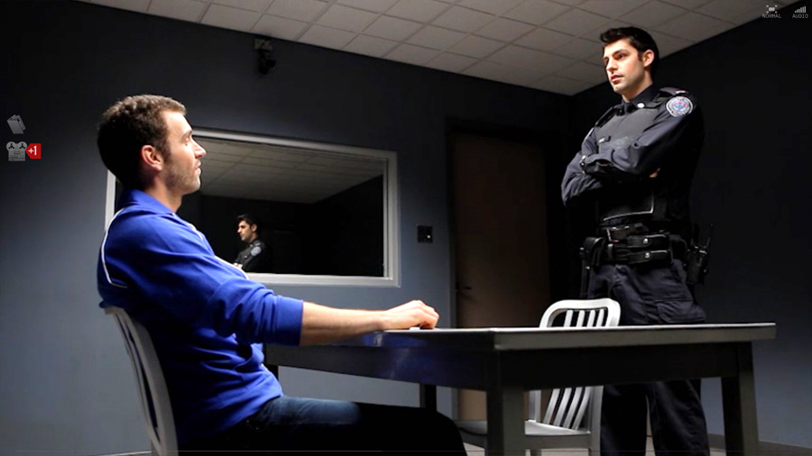
Who, When, and Where

Slide 6

Stories Are Complicated
The dynamic relationships of characters

Slide 7
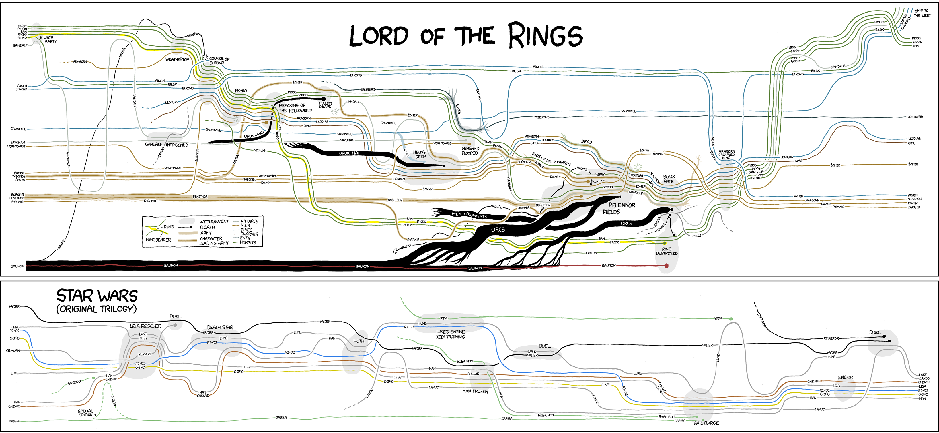
Randall Munroe’s Storyline Visualization

Slide 8
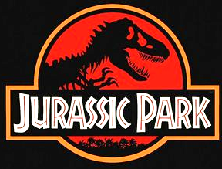
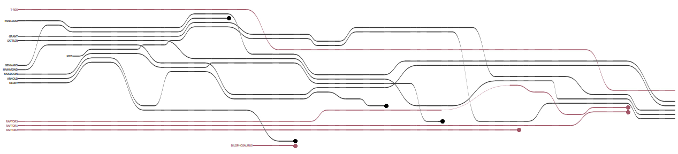
Storyline Visualization
time

Slide 9

Storyline Visualization
One character
T-Rex
Dinosaurs
Human
time

Slide 10
Storyline Visualization
Five characters in the same scene
Dinosaurs
Human
time

Slide 11
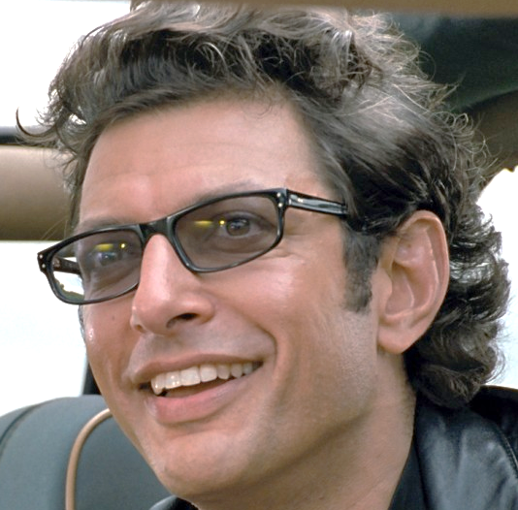
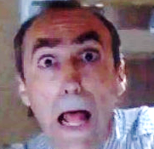
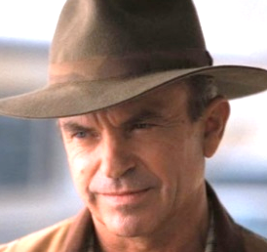
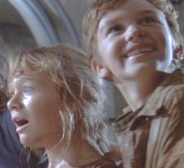
Storyline Visualization
Dinosaurs
Human
time

Slide 12
Storyline Visualization
time

Slide 13
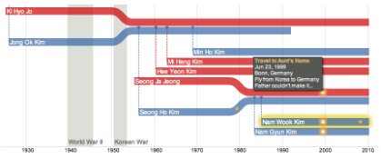
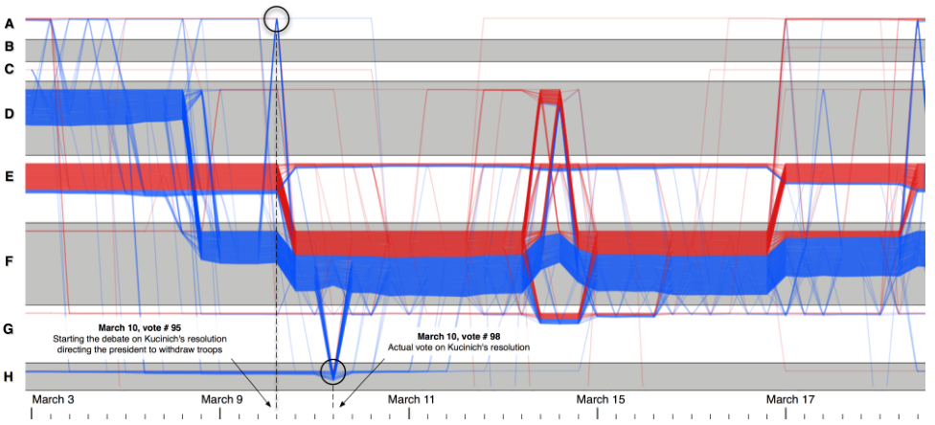
Storyline Visualization Applications
Tracing genealogical data
Tracking community evolution
Kim et al. 2010
Reda et al. 2011

Slide 14
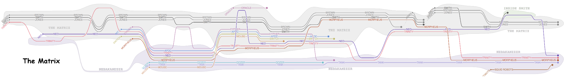
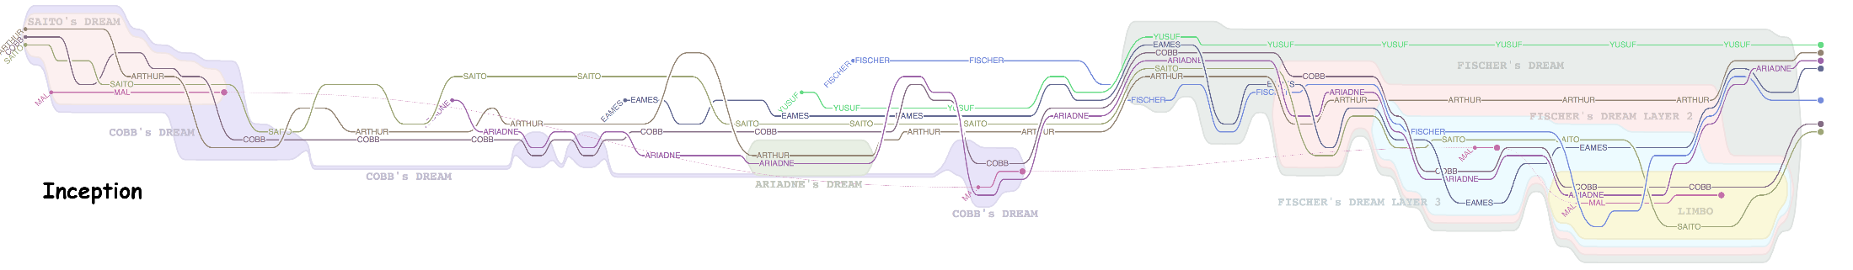
General Storyline Layout
Yuzuru Tanahashi and Prof. Kwan-Liu Ma’s work
Dreams inside dreams

Slide 15

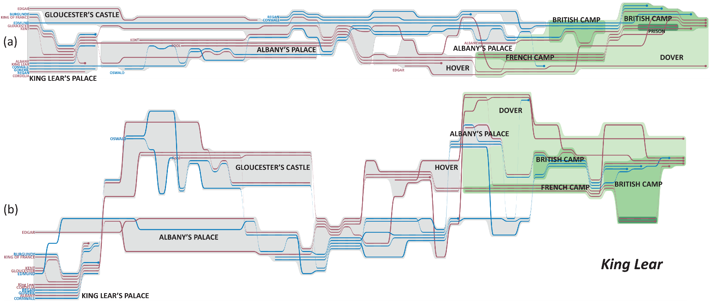
Hierarchical Locations

Slide 16
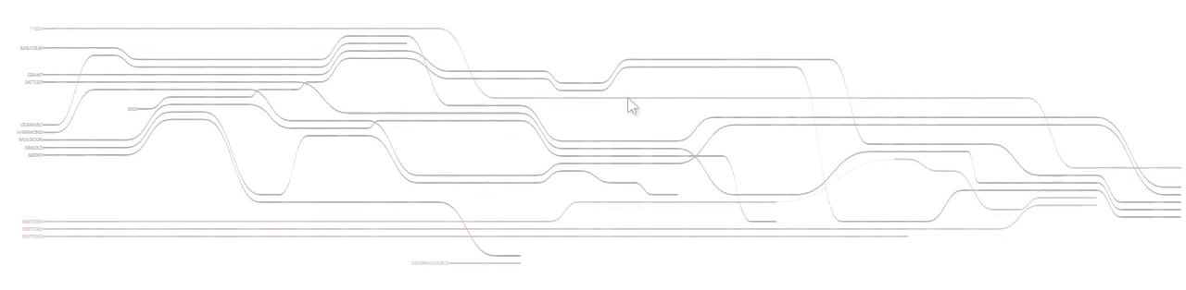
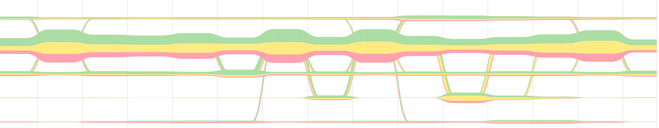
StoryFlow
Real-time interactions
Level-of-detail rendering
Location hierarchy
First debate VP debate Second debate Third debate

Slide 17
Outline
Introduction
Optimization Framework
StoryFlow Layout
Interactive Exploration
Experiments
Conclusion

Slide 18
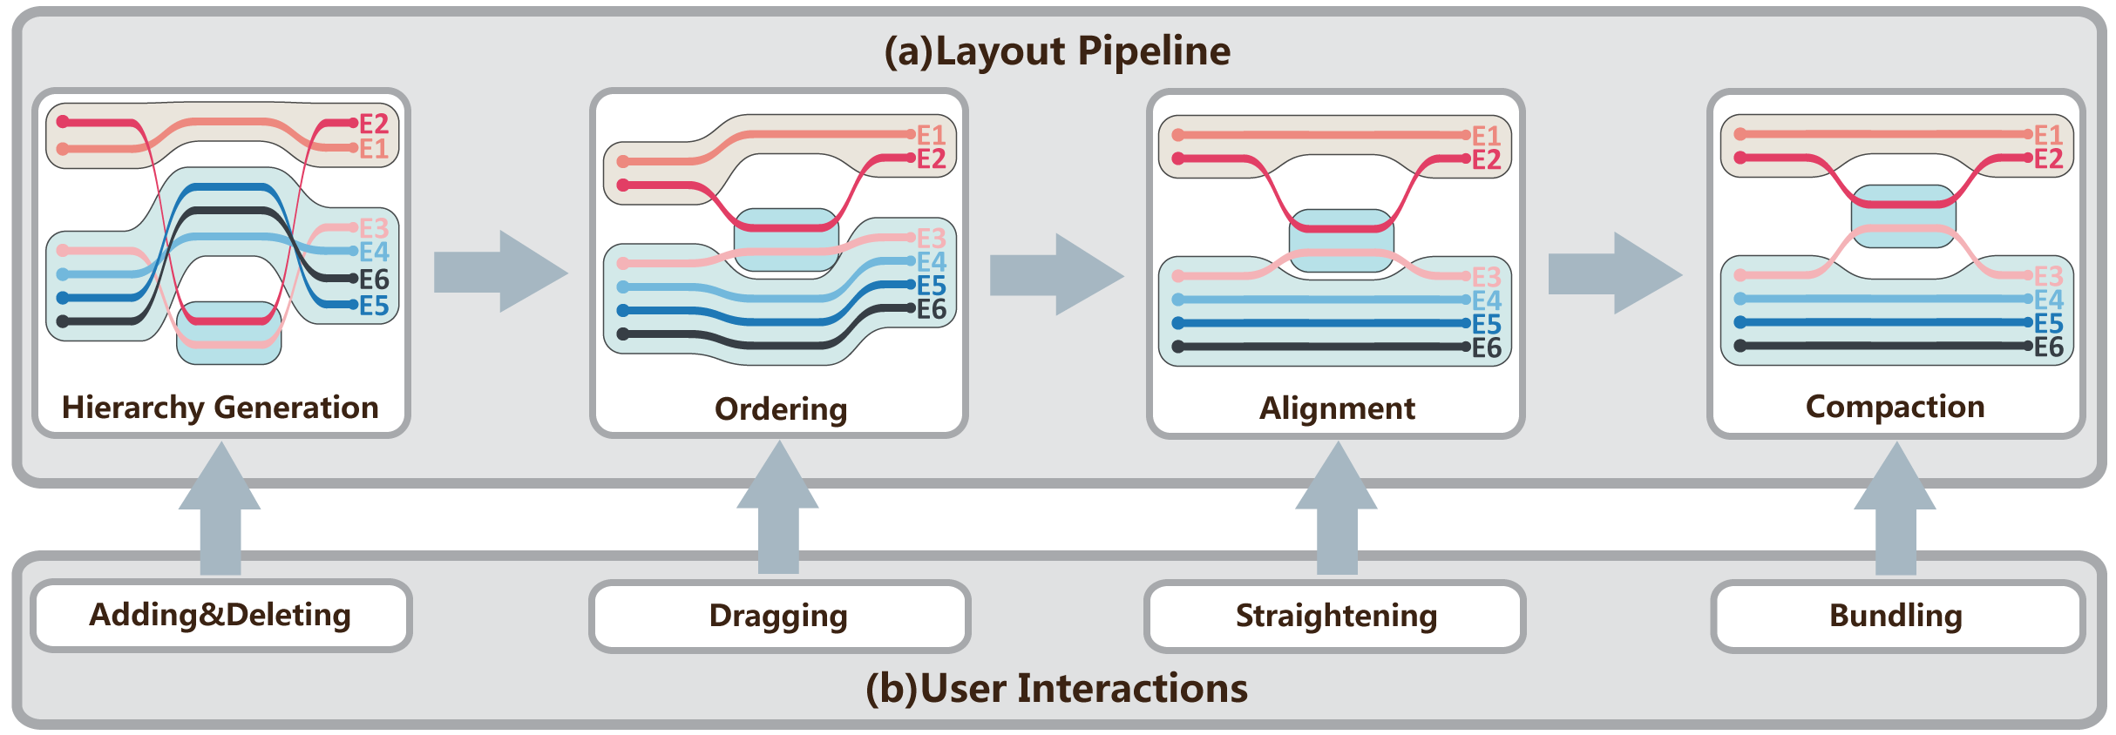
System

Slide 19
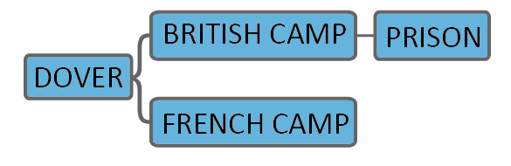
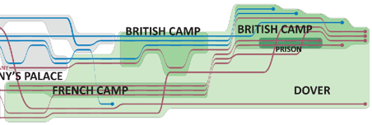
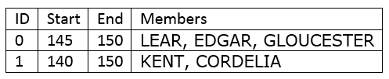
Input Data
Location hierarchy
Session list

Slide 20
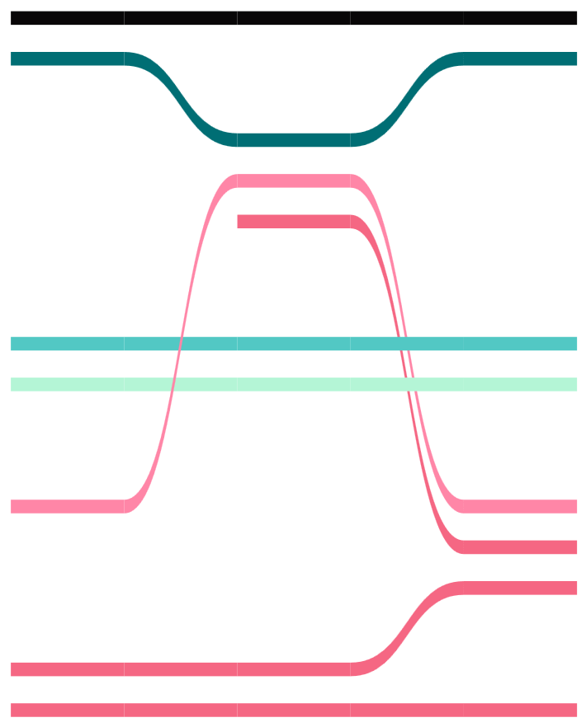
Objectives
Crossings
Wiggles
White Space

Slide 21
Optimization Strategy
Importance
decrease
Crossings
Discrete
Number of wiggles
Wiggle distance
Wiggles
Wiggle distance
Continuous
White space

Slide 22
Outline
Introduction
Optimization Framework
StoryFlow Layout
Interactive Exploration
Experiments
Conclusion

Slide 23
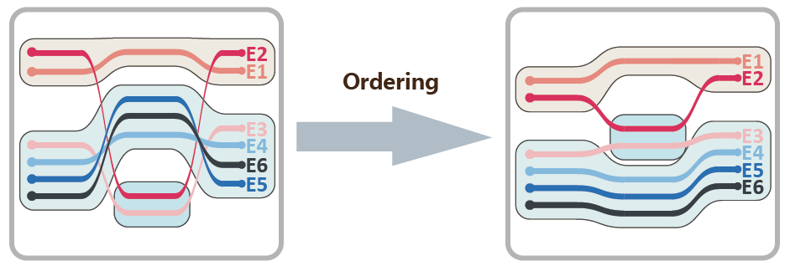
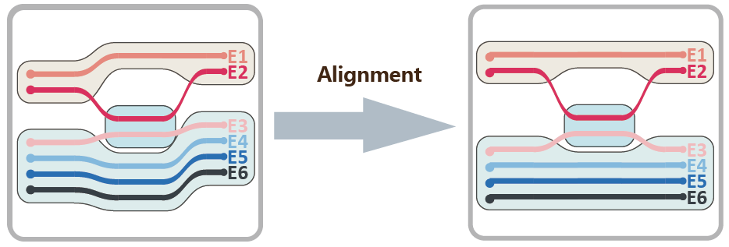
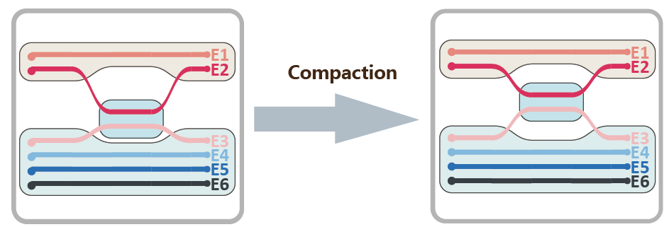
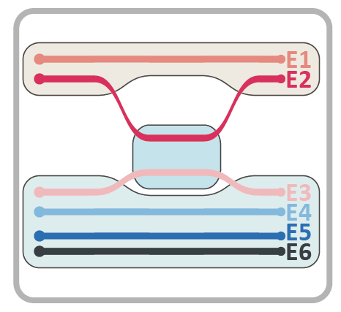
Discrete and Continuous optimization
Discrete optimization
  Edge crossings
  Number of wiggles
Continuous optimization
  Wiggle distance
  White space

Slide 24
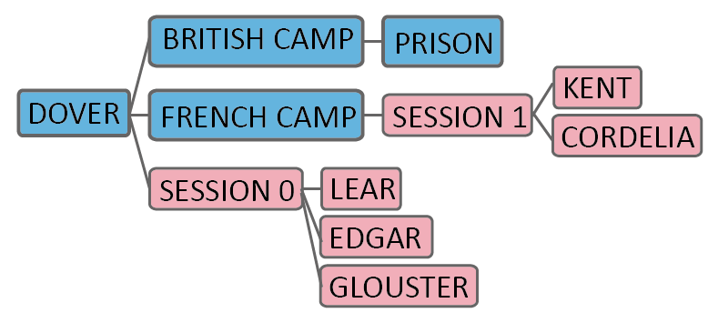
Hierarchy Generation
Location tree
Session list
Relationship trees

Slide 25
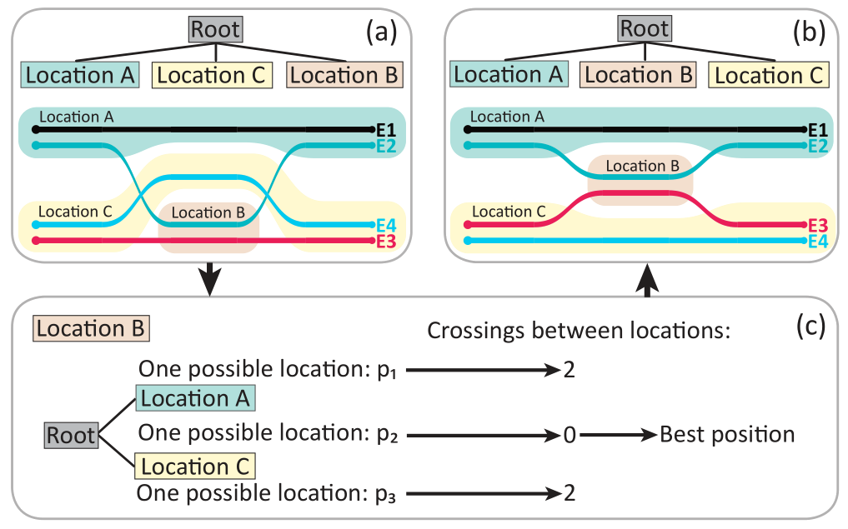
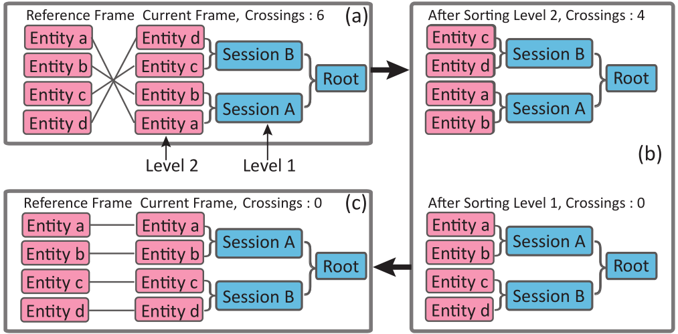
Ordering
1. Sorting location nodes using a greedy algorithm from bottom to top
2. Ordering sessions based on a DAG barycenter sweeping algorithm

Slide 26
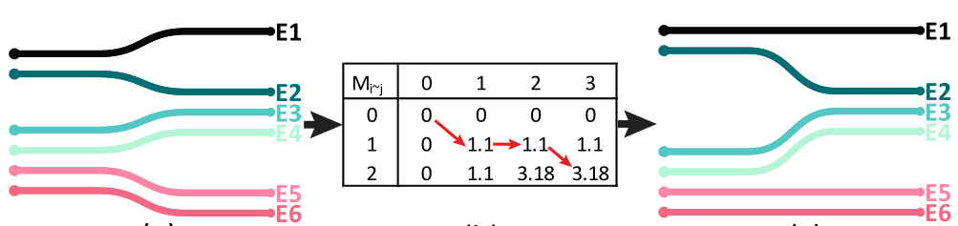
Alignment
ABCDEFG
Longest common subsequence
BCDG
BCDGK

Slide 27
Compaction
Quadratic programming
Subject to
Line order
Line alignment
Line adjacency
Line separate

Slide 28
Outline
Introduction
Optimization Framework
StoryFlow Layout
Interactive Exploration
Experiments
Conclusion

Slide 29
System

Slide 30
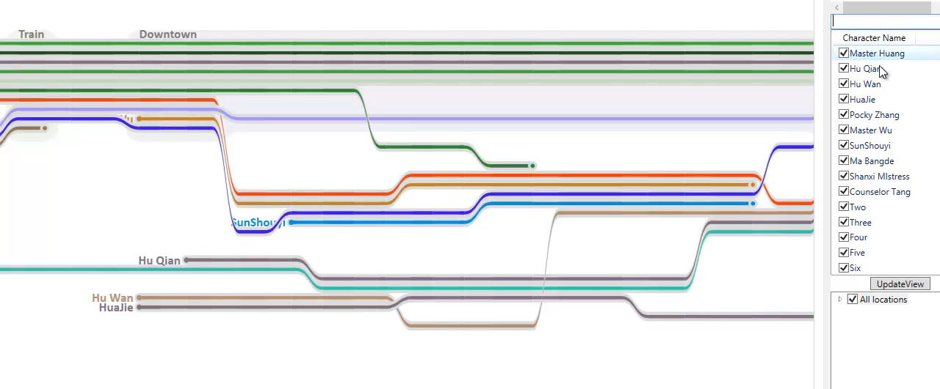
User Interactions

Slide 31
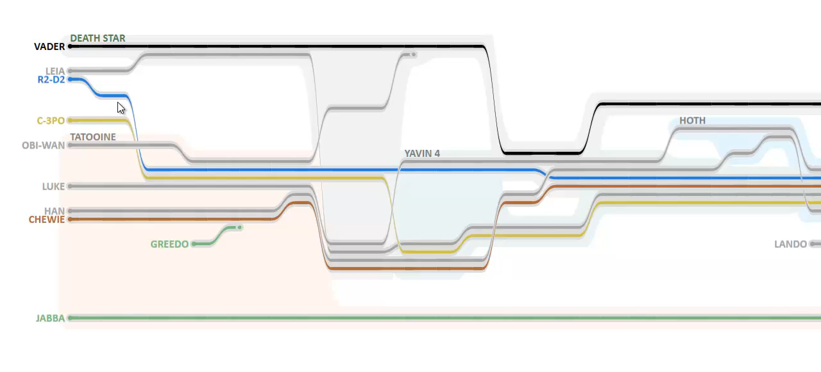
User Interactions

Slide 32
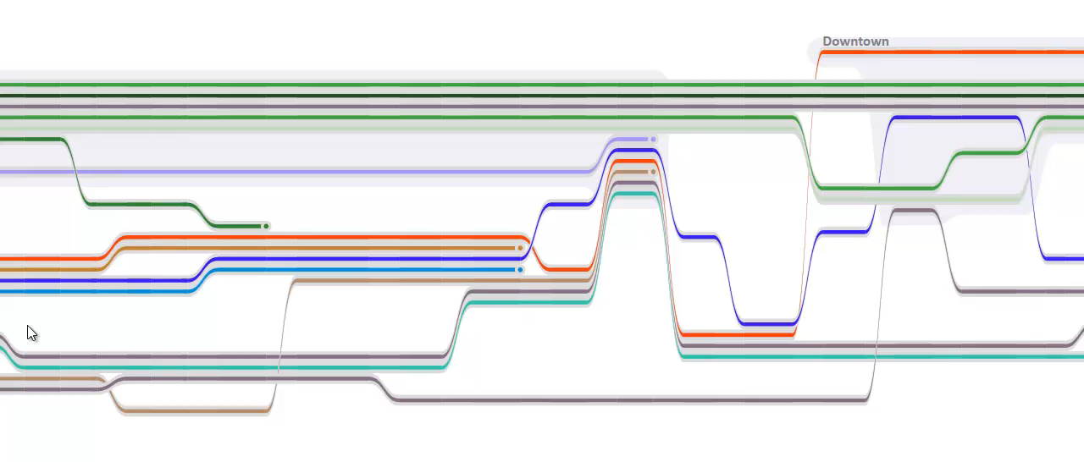
User Interactions

Slide 33
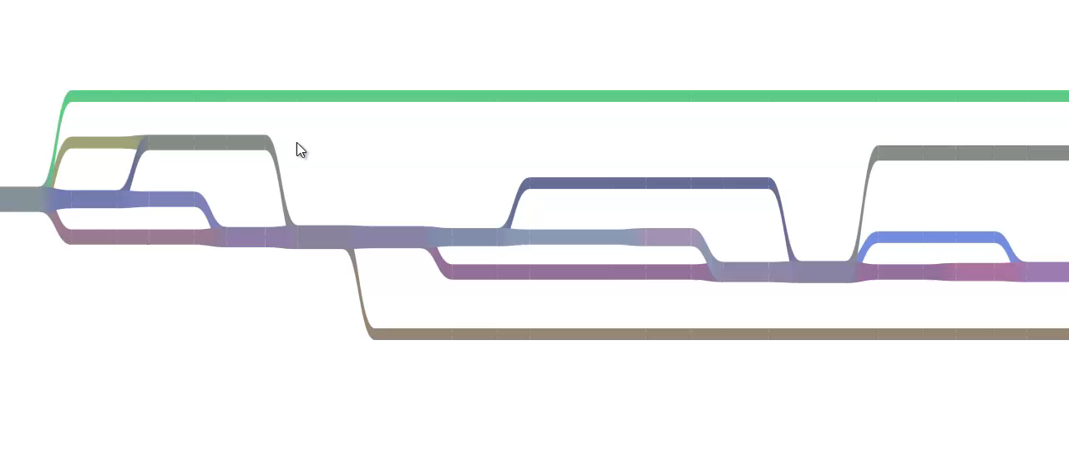
User Interactions

Slide 34
Outline
Introduction
Optimization Framework
StoryFlow Layout
Interactive Exploration
Experiments
Conclusion

Slide 35
Evaluation
1
Quantitative Analysis
2
Movie Examples
3
Case Study

Slide 36
Quantitative Analysis
Intel i7-2600 CPU (3.4GHz)
8GB memory
 | Data |  | Time(s) |  | Crossings |  | Wiggles
 | #Entity | #Frame | Ours | GA | Ours | GA | Ours | GA
Star Wars | 14 | 50 | 0.16 | 129.79 | 48 | 93 | 82 | 133
Inception | 8 | 71 | 0.16 | 149.67 | 23 | 99 | 88 | 162
Matrix | 14 | 42 | 0.16 | 172.47 | 14 | 43 | 54 | 94
MID | 79 | 523 | 0.60 | >10^5 | 1267 | 1871 | 831 | 874
GA refers to Tanahashi and Ma’s method based on Genetic Algorithm (GA)

Slide 37
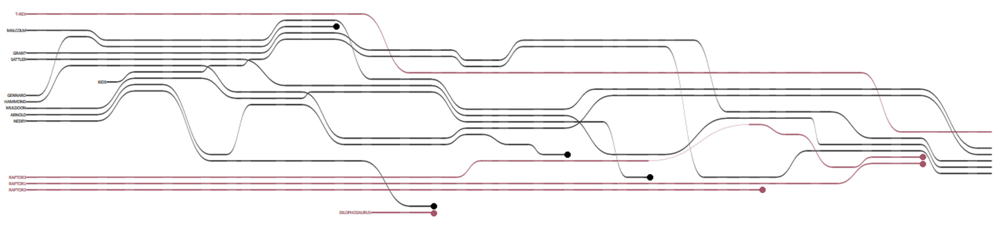
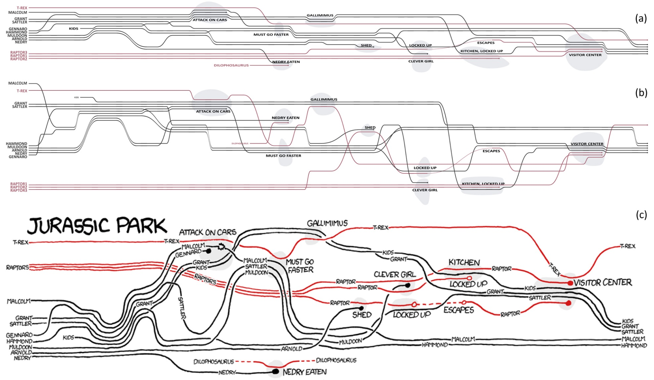
Jurassic Park
(a)
Our method
GA method
Randall’s work

Slide 38
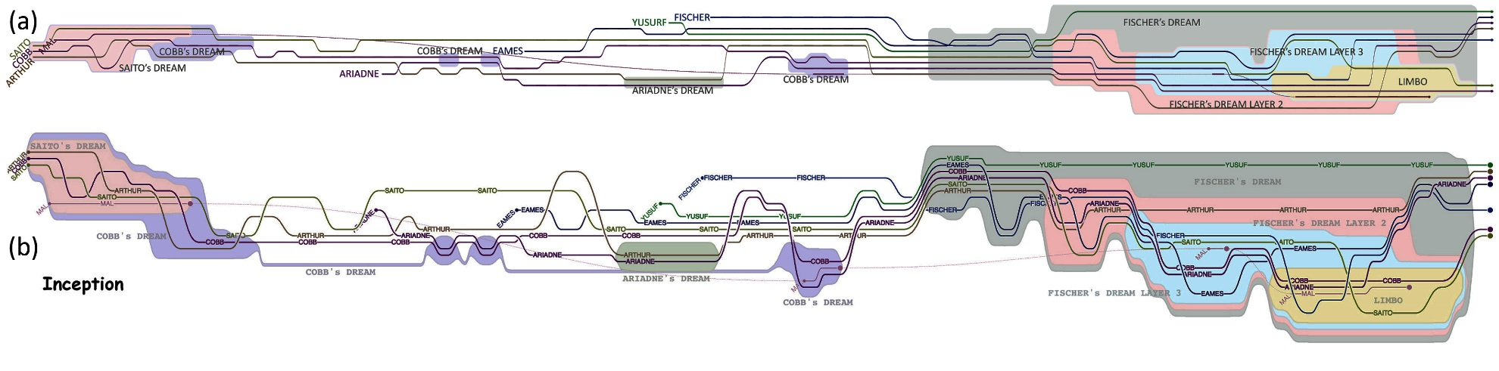
Inception
Our method
GA method

Slide 39
King Lear
Our method
GA method

Slide 40

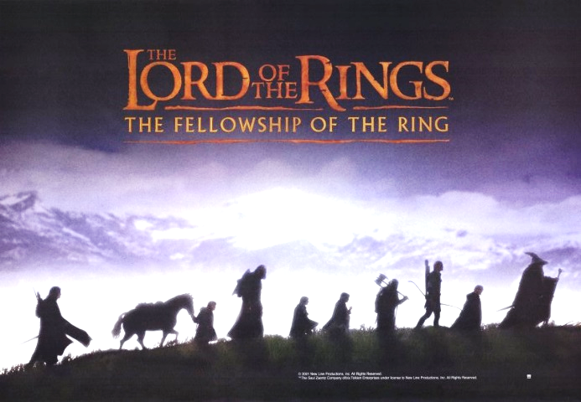
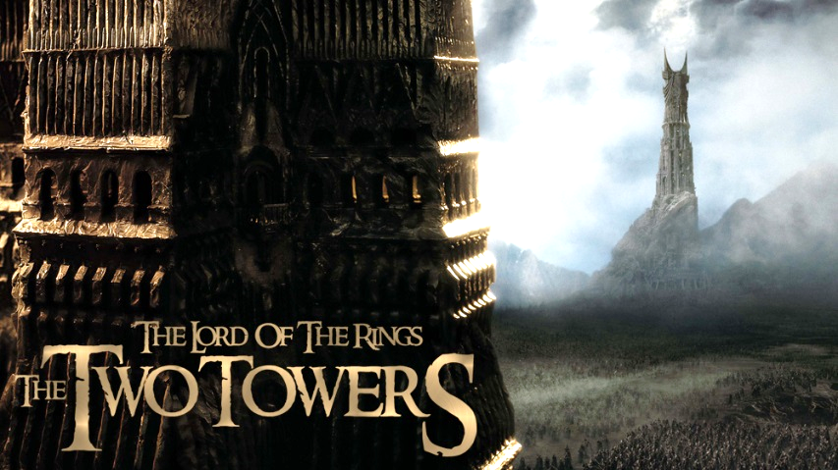
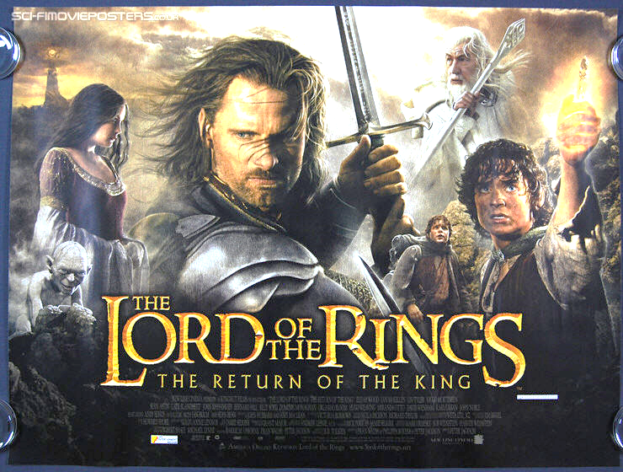
The Lord of the Rings Trilogy

Slide 41
US 2012 Presidential Election
  2012 US presidential election Twitter Data
    89,174,308 tweets from May 01, 2012 to November 20, 2012
    900 users: politicians (334), media (288), and grassroots (276 )
    Two-level location hierarchy
      Five hot topics: Welfare, Defense, Economy, Election, and Horse race
      2,344 hot hashtags
    Session List
ID | Hashtag | Start | End | Members
0 | Hashtag1 | 140 | 167 | Opinion leader A, Opinion leader B
1 | Hashtag2 | 145 | 180 | Opinion leader C, Opinion leader D

Slide 42
Overall Patterns (1/2)
Five significant events on Election
  First debate, VP debate, second debate, and third debate
Grassroots
Media
Political Figures
Defense
Election
First debate VP debate Second debate Third debate Voting
Economy
Welfare
Horse Race
Timeline

Slide 43
Overall Patterns (2/2)
Three user groups focused mainly on Election
  Grassroots also focused on Economy and switched frequently
  Political figures were more focused
  Media occasionally switched
Grassroots
Media
Political Figures
Defense
Election
Economy
Welfare
Horse Race
Timeline

Slide 44
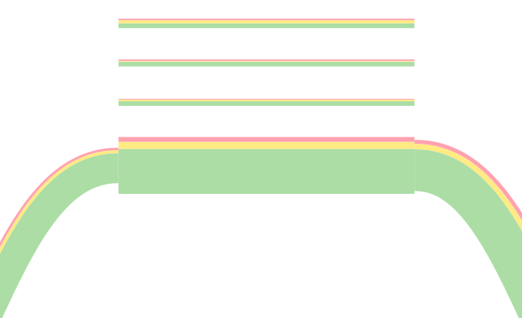
Significant Transition
Transition from Election to Economy
Grassroots
Media
Political Figures
Defense
Election
First debate VP debate Second debate Third debate Voting
Economy
Welfare
Horse Race
Timeline
think Romney is tough on china? ask the workers of #sensata about that as they train their Chinese replacements
Sensata
tlot
teaparty
gop

Slide 45
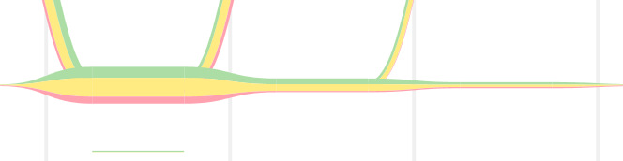
Significant Transition
Transition from Election to Economy
Grassroots
Media
Political Figures
Defense
Election
First debate VP debate Second debate Third debate Voting
Economy
Welfare
Horse Race
Timeline
Issue-attention cycle
sandy
fema

Slide 46
Outline
Introduction
Optimization Framework
StoryFlow Layout
Interactive Exploration
Experiments
Conclusion

Slide 47
Conclusion
A Storyline visualization system
  An efficient hybrid optimization approach
  A hierarchy-aware storyline layout
  A method for interactively and progressively rendering
Future improvements
  Flashback narrative

Slide 48
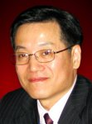

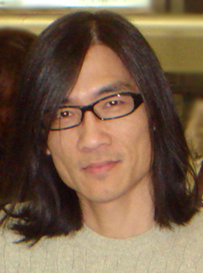
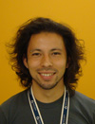
Acknowledgements
Prof. Jonathan J.H. Zhu @ CityU, Hong Kong
Prof. Tai-Quan Peng @ NTU, Singapore
Prof. Kwan-Liu Ma and Yuzuru Tanahashi @ UC Davis

Slide 49
Thank you
Email: yingcai.wu@microsoft.com

