Slide 1



A Visual Reasoning Approach for Data-driven Transport Assessment on Urban Roads
Fei Wang¹, Wei Chen¹, Feiran Wu¹, Ye Zhao², Han Hong¹, Tianyu Gu¹, Long Wang¹, Ronghua Liang³
and Hujun Bao¹
Notes:
Good Afternoon everyone. I am Fei Wang from Zhejiang University.
Today I would like to present our paper “A Visual Reasoning Approach for Data driven Transport Assessment on Urban Roads”.

Slide 2
Outline of Presentation
Motivation
Our approaches
  Road-based Query Model
Visual Design for Traffic Analysis
Case Study
Conclusion and Future Work
Notes:
My presentation includes five parts.
First, we give a brief description about why we do this work and what challenges are.
Second, we introduce our approaches.
Then, we explain how we design for traffic analysis
We also describe several cases to verify our results.
At last, we conclude and talk about the future work.

Slide 3
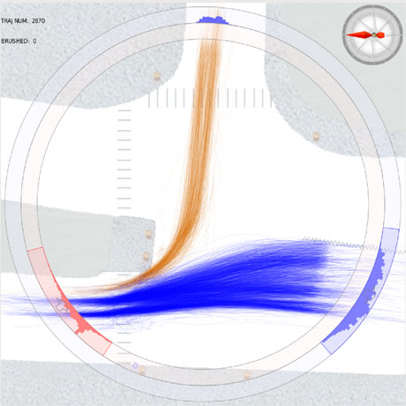
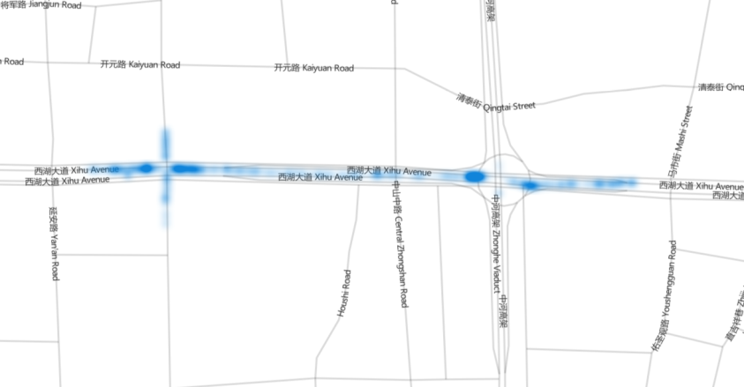
Motivation
Human centered traffic assessment is costly
Trajectory-based analysis can cut costs
  Traffic assessment should be dynamic, analyst-driven
  Querying trajectory data is time-consuming because of high data volume
Notes:
As we know, traffic assessment, especially human centered traffic assessment often needs much money and effort
Trajectory based analysis can cut costs. Many previous works have proved their effectiveness. For example, investigating microscopic traffic patterns of road intersections.
However traffic assessment should be dynamic and analyst driven.
If we want to know traffic situations on a road, we should filter data on this road. We can use a brushing tool or a lasso tool. And then, querying trajectory data is time-consuming. Look at the right figure, the running time grows exponentially with the increment of data volume when querying trajectories in DB.

Slide 4
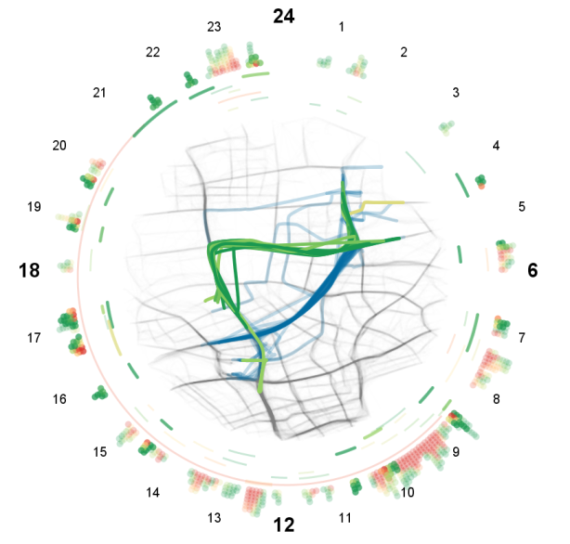
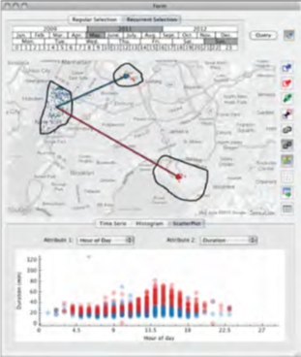
Macro-pattern Analysis
  Global phenomena in a large area
Zheng Y., UbiComp’11
Liu H., VAST’11
Micro-pattern Analysis
Detailed patterns on a street or an intersection
Wang Z., VAST’13
Ferreira N., VAST’13
Notes:
Previous works on traffic analysis fall into two categories. One is macro-pattern analysis. In this category, global phenomena are presented in a large area, such as a city or a district. In the left work, a hot map shows the number of people reaching a region by taxis in an hour. Another work visualizes road diversity based on trajectory data.
The other is micro-pattern analysis. In micro-pattern analysis, detail patterns on a street or an intersection are studied. The left work analyzes the propagation of traffic jams at specific road segments. Another work provides a visual query tool on OD data.

Slide 5
Problem: the MBR representation creates large empty space
SETI
  Segments that
  are spatially close will be saved in the same disk
Problem: many line segments outside the query space may be included in the candidate set
3D R-Tree
  Assume that time is another
  dimension
  Store objects as their 3D MBR
Notes:
For trajectory index, 3D R-Tree unifies the temporal dimension and the spatial dimension, and stores objects as their 3D MBR. For this index, the problem is the MBR representation creates large empty space.
SETI is a well-organized index for trajectory data. Segments that are spatially close will be saved in the same disk. It employs a sparse index for time. So the problem of SETI is that many line segments outside the query space may be included in the candidate set, probably resulting in a severe waste of processing time and resources.

Slide 6
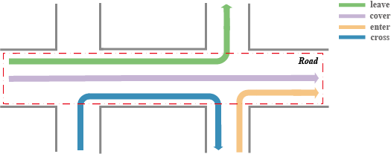
Road-based Query Model
Region of Query, R
  A collection of grid cells on the map
Topology, ω
  Relationships between moving objects and roads
Road-based Query
  Search on a trajectory corpus
  in R and [t0, t1]
  Returns trips with ω
Notes:
To focus on trajectory data, we propose a road-based query model. At first, we give several definitions.
A region of query is a collection of grid cells on the map, which approximates a road segment
A topology mode of trips describes the relationships between moving objects and roads, such as enter, leave, cover and cross
So, We say a road based query executes a searching on a trajectory corpus in a region of query and a time interval, which returns trips with specific topology.

Slide 7
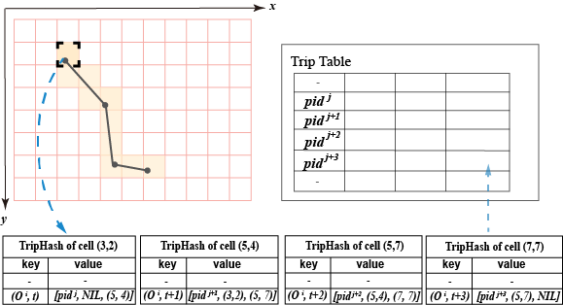
TripHash Index
Spatial space
  The map is gridded
Temporal space
  Two neighbor points of a trip connect each other
A bidirectional linking hash index
Notes:
To make road-based query complete in real time, we design a new index, named TripHash.
Look at this, the map is gridded into cells. Each cell includes a TripHash. If a trip passing a cell, it will be stored in a key-value fashion.
The key includes a trip id and a timestamp. All points of a trip are connected with respect to the key by their cell Numbers.
So, TripHash is a bidirectional linking hash index.

Slide 8
Trip Query Modes
Find Trips in a Road
  Returns trips passing all or a part of selected cells
Find Entire Trips
  Returns entire trips of the last query result
Notes:
Next, we should talk about the query modes. We define two kinds of query modes.
One is to find trips in a road, which means it will return trips passing all or a part of selected cells. The other is to find entire trips.
Let’s give an example. If four cells are selected, which trips will be returned?

Slide 9
Trip Query Modes
Find Trips in a Road
  Returns trips passing all or a part of selected cells
Find Entire Trips
  Returns entire trips of the last query result
Notes:
In the first mode, the orange line with 5 points and the blue line with 3 points will be found.
In the second mode, both lines are returned. But the blue line includes four points, even though the last point exceeds the search scope.

Slide 10
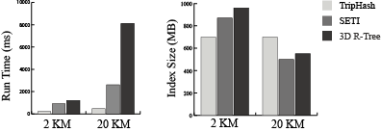
Performance Evaluation
We compare TripHash with SETI and 3D R-Tree for distances of 2 KM and 20 KM
  500 taxis about 0.5 million GPS points
  TripHash
  best in terms of the run time.
  more space in the long distance query
  but quickest query response
Notes:
We have made performance evaluations and compare TripHash with SETI and 3D R-Tree for distances of 2 Kilometers and 20 KM.
We use the real data of 500 taxis about 0.5 million GPS points.
TripHash performs the best in terms of the run time.
Though TripHash calls for more space to cache the index in the long distance query, it has the quickest response.

Slide 11
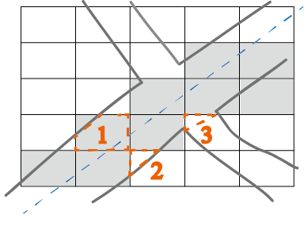
Road-based Visual Query
Sketch-based Dynamic Query
  A brushing tool to filter trajectories
Cell size
  Balance performances of time and space (55 Meters)
Brushing on roads
  Constrained to the road when brushing
  Cell selection based on coverage (>75%)
Notes:
We also provide a brushing tool to filter trajectories on roads
There are two problems that we have to deal with.
First, we need to optimize the cell size. In this paper, we want to balance performances of time and space. We set it as 55 meters with respect to the width of roads and the speed of taxis.
Second, we need to determine how the brushing tool goes on roads. The brush is constrained to the road when filtering data.
And if a cell is mostly covered by a road, we take it. In this figure, Cell No.1 will be taken, and Cell No.2 and No.3 will not.

Slide 12
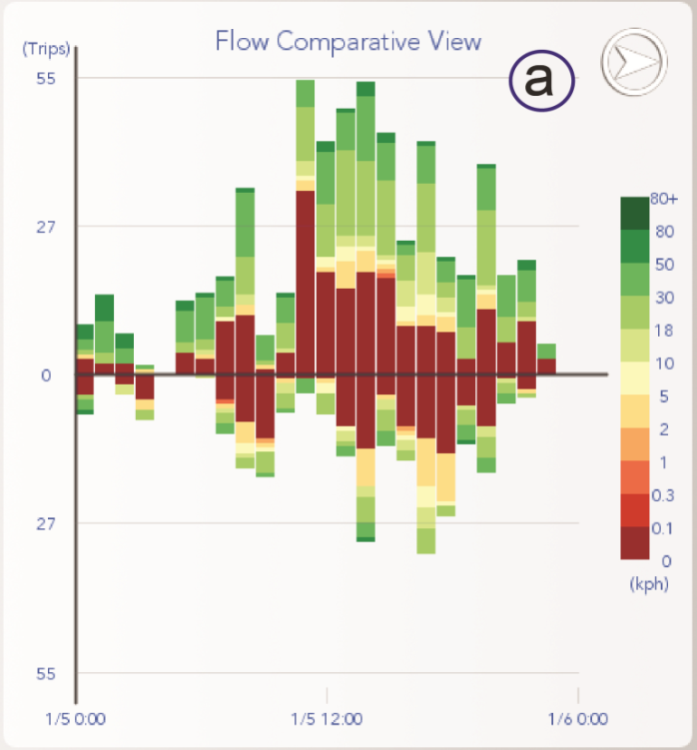
Design Rationale
Traffic flow of two directions
trips
Flow Comparative View
  A comparative view
  Stacked bar chart
time
Notes:
We design multiple views to support analysis.
The design rationale includes four items.
We want to compare traffic flow of different directions. So we design the Flow Comparative View.
The horizontal axis stands for time, and the vertical axis stands for trips in two directions.

Slide 13
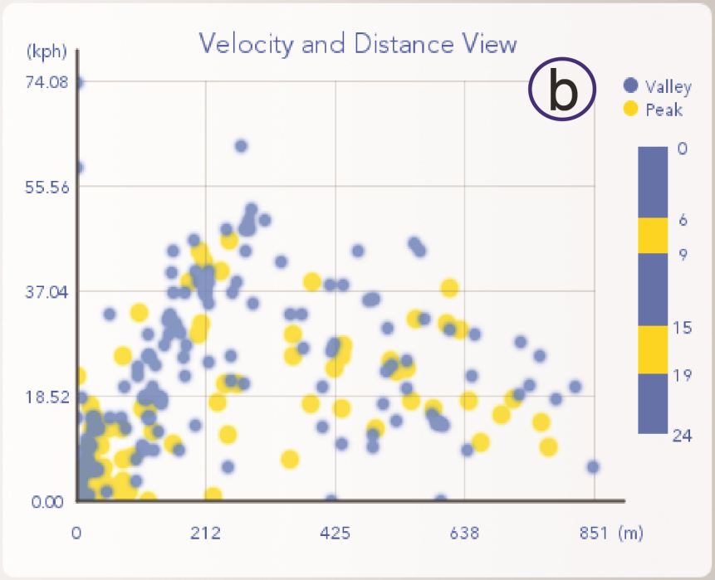
Design Rationale
Traffic flow of two directions
Relationships between distance and speed
Velocity and Distance View
  patterns
    lower left
    upper right
velocity
distance
Notes:
We want to display the relationships between the travelling distance and the vehicle speed
We design the Velocity and Distance View. The horizontal axis stands for the travelling distance and the vertical `stands for the velocity.
From this view, one can find two basic patterns.
if there are many points at the lower left, the road is in a bad situation
On the contrary, if there are many points at the upper right, drivers can run longer and faster.

Slide 14
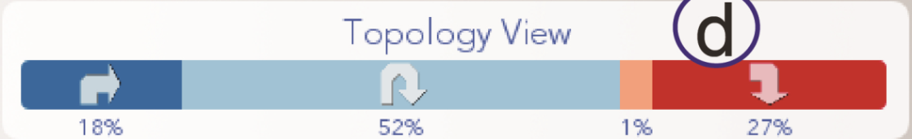
Design Rationale
Traffic flow of two directions
Relationships between distance and speed
Topology patterns
Topology View
  Ratios of trips in different topology modes
Notes:
We want to visualize topology patterns of traffic flow
We use a bar chart to represent the ratios of trips with different topology modes by four different colors and glyphs
In this example, fifty two percent cars want to cross a road.

Slide 15
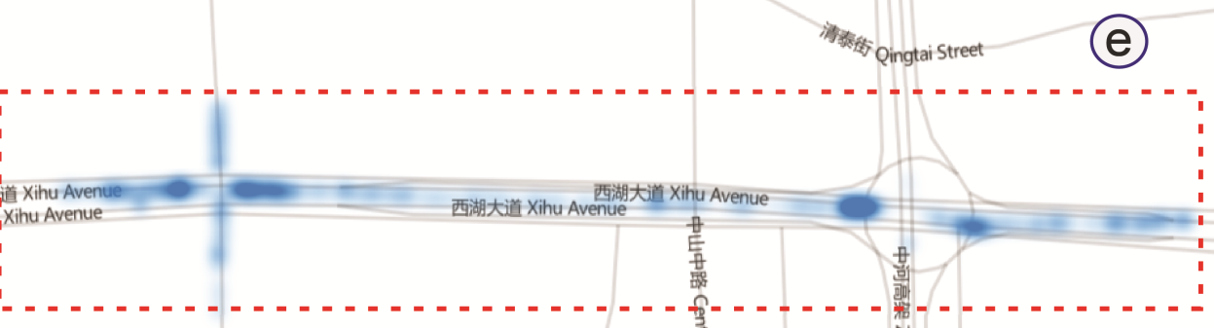
Design Rationale
Traffic flow of two directions
Relationships between distance and speed
Topology patterns
Density of traffic flow
Flow Density View
  Spatial distribution of traffic flow on a map
Notes:
And then, we want to present the density of traffic flow on a road
In the Flow Density View, spatial distribution of traffic flow on a map will be visualized.
We highlight areas with high flow density.

Slide 16
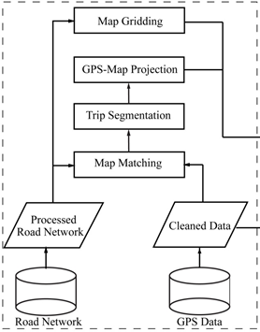
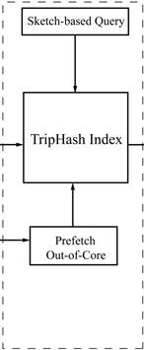
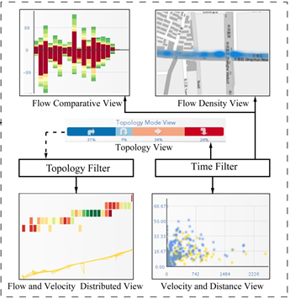
The Pipeline of Our System
Preprocessing
Road-based Query
Visual Analysis and Reasoning
Notes:
Before case study, let’s overview the pipeline of our system
The flow consists of three stages:
At the first stage, the raw data are cleaned and reorganized. And then, these data are stored in TripHash index.
At the second stage, analysts can use a sketch-based query tool to find trajectories.
At the last stage, multiple views are designed to support analysis and reasoning.
Now let’s take a look at some cases.

Slide 17
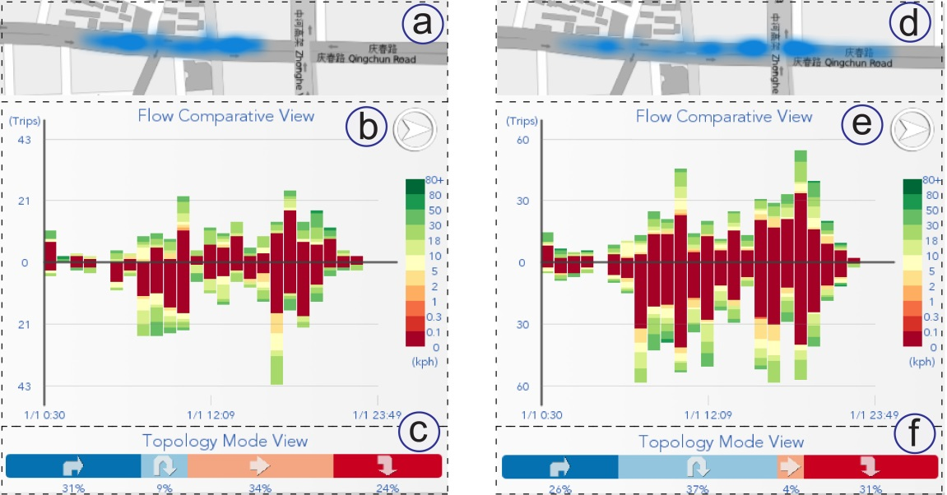
Case 1: Watershed-like Pattern of an Intersection
Brush to the left of the intersection
  Cover flow takes up 34%
Brush over the intersection
  Cross flow jumps to 37%, cover flow drops to 4%
Watershed-like pattern
  A lot of cars reroute at an
  intersection
Notes:
In the first case, experts find a watershed-like pattern of an intersection. If brushing to the left of the intersection, the cover flow takes up thirty four percent.
This means that one third cars want to go through this street.
Meanwhile, when brushing over the intersection, the cover flow drops to 4% and the cross flow jumps to thirty seven percent.
So, a lot of cars reroute at this intersection. We call this phenomenon as the watershed-like pattern.

Slide 18
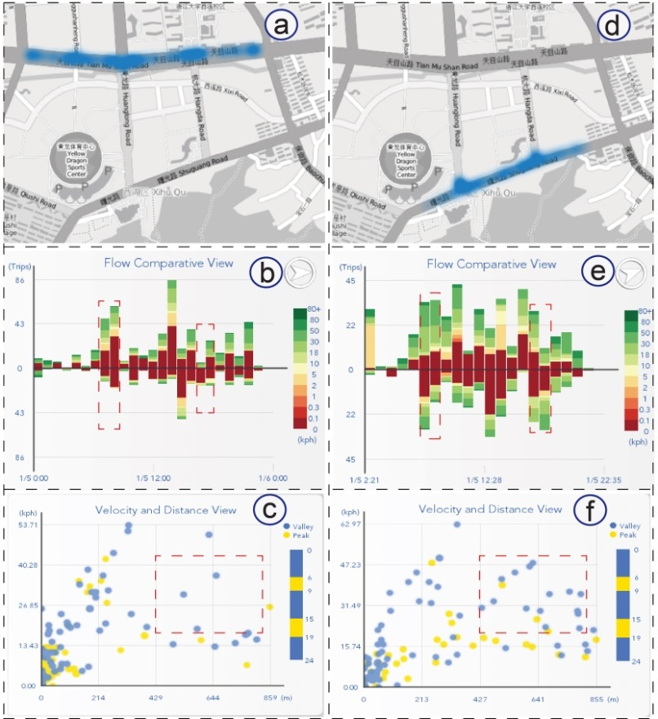
Case 2: Patterns on a Road with Reversible Lanes
Two parallel roads are selected
  a←→d
Traffic flow on the right is more balanced than the left
  b←→e
Drivers can run faster on reversible lanes
  c←→f
Traffic situation on the road with reversible lanes is better
an ordinary road
a road with reversible lanes
Notes:
In case two, we compare traffic patterns on two roads and one road has reversible lanes. In this case, two parallel roads are selected, see view a and d.
Comparing view b and e, one can find that traffic flow on the right is more balanced than the left.
From the view c and f, one can find that there are more points at the upper right. That means drivers can run faster on reversible lanes.
So we know that traffic on the road with reversible lanes is better.

Slide 19
Conclusion and Future Work
A visual analysis system for interactive traffic assessment
Comments from domain experts
  Provide a qualified interactive road assessment method
  Call for fewer analysts and devices
  Detect interesting potential phenomena
Future work
  More flexible widgets for time query
  Better interaction tools
  More data sources
Notes:
Since time is limited, we only talk about two cases, there still are some cases in our video. Let’s give a summary. This paper proposes a visual analysis system for interactive traffic assessment.
We cooperate with domain experts, and they say our system is much helpful for them.
However, our system also has some limitations. We are going to improve it in the future.
such as POI data and public transportation data

Slide 20
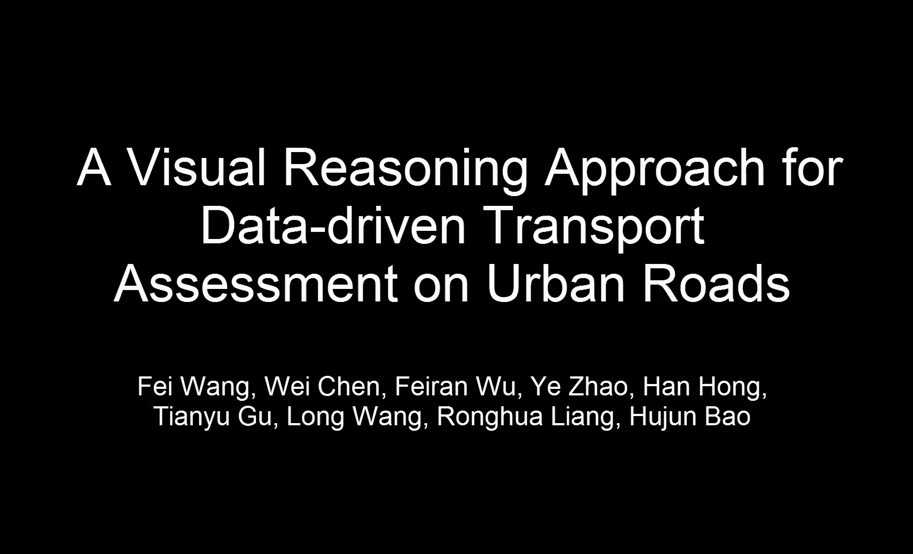
THANKS
Email: wolflyecn@gmail.com
Notes:
Thank you very much for your kind attention. Any question would be appreciated.

