Slide 1
Hongzhi Wu^{1,2}, Li-Yi Wei¹, Xi Wang¹, and Baining Guo¹
Microsoft Research Asia¹ Fudan University²
Silhouette Texture

Slide 2
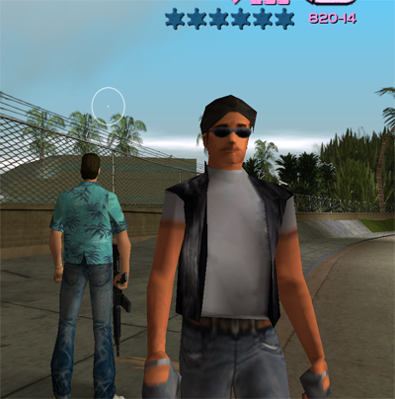

Problem
Silhouettes are important
  Visual cues for human perception system
Render detailed silhouettes is expensive
  low-polygon count objects causing jagged silhouettes
Grand Theft Auto
World of Warcraft

Slide 3
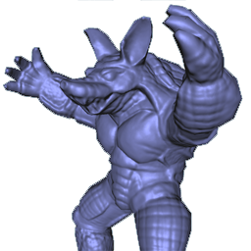
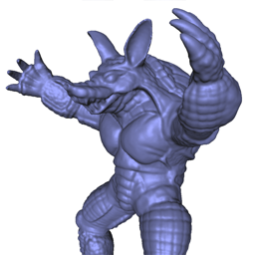
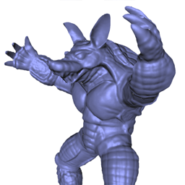
Our Solution
Render high quality silhouette with low polygon count
  In the spirit of Silhouette Clipping [Sanders et al 00]
Load balance for pixel for vertex stages
  GPU today was optimized for ~ 10 pixels per vertex
  (not true for dense meshes)
Outer hull + Normal map
Original Mesh (308 fps)
Our method (725 fps)

Slide 4
Previous Work
Silhouette Clipping [Sanders et al 00]
  Exterior silhouettes only
  Explicit storage of all original edges
  Not GPU friendly
VDM/GDM [Wang et al 03,04] and Relief Mapping [Policarpo et al 05]
  Mainly for interior texture details
  Difficulty in handling silhouettes
Interactive Horizon Mapping [Sloan et al 00, Heidrich et al 00]
  Similar data structure, but for self-shadowing

Slide 5
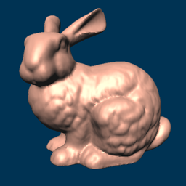
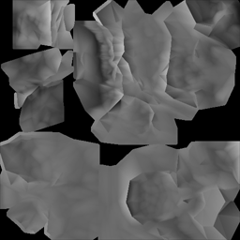
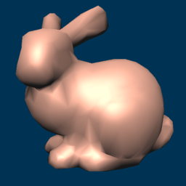

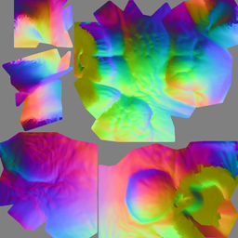
Overview
Original Mesh
Simplify
Silhouette Texture
+
Preprocess
Render
Outer hull
Final Result
Normal Map

Slide 6
Correspondence: Outer hull and Original mesh

Slide 7
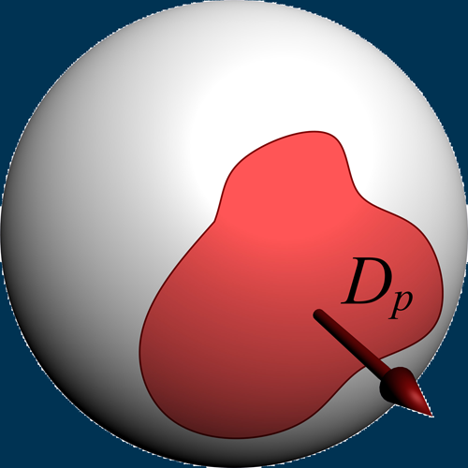
Visibility Function
Our basic data structure for rendering silhouette
2D
3D

Slide 8
Algorithm Illustration
hit
miss

Slide 9
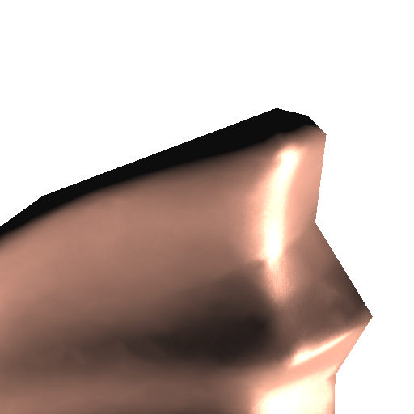
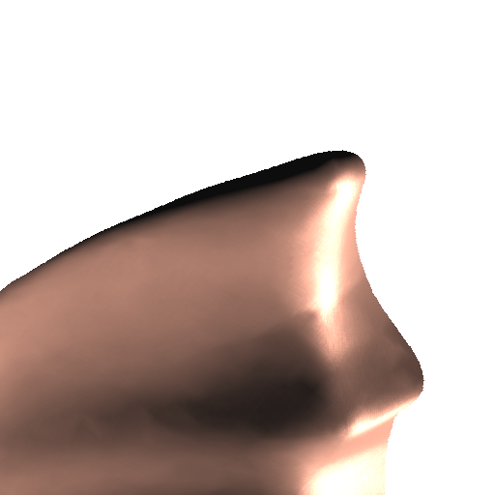
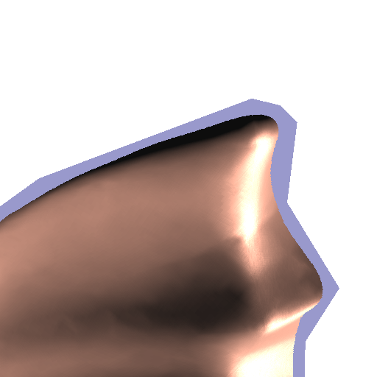
Quality Comparison
Normal map
Our approach
Difference

Slide 10
Incorrect Interior Silhouettes
(Naïve Visibility Function)
correct
incorrect

Slide 11
Correct Interior Silhouettes
(Modified Visibility Function)
correct
incorrect

Slide 12
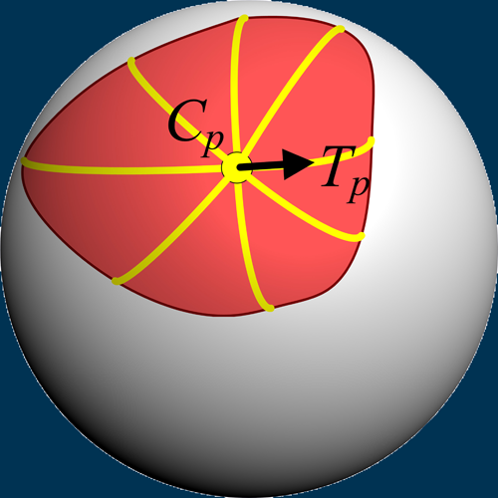



Sampling Visibility Function
Store sampled spoke length into an 1D array
1
2
3
4
5
6
7
8
4
3
2
1
5
limitations
8
6
7

Slide 13
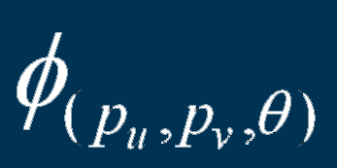
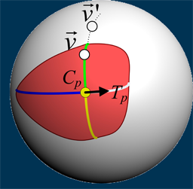

Silhouette Texture Encoding/Decoding

Slide 14
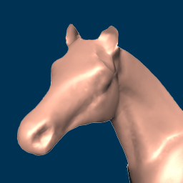
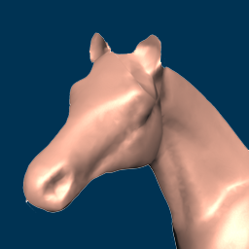

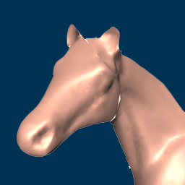
SVD Compression
Uncompressed
25% Compression Rate
12.5% Compression Rate
6.3% Compression Rate

Slide 15
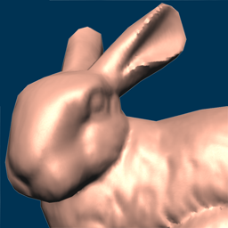
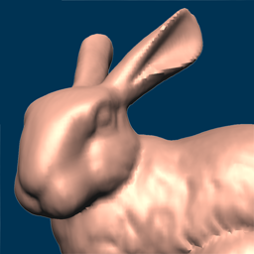
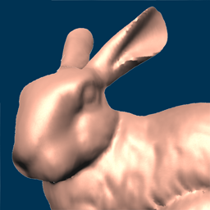
Results
Bunny
Outer hull + Normal map
Original Mesh (411 fps)
Our method (638 fps)

Slide 16
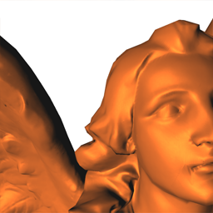
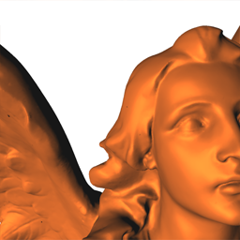
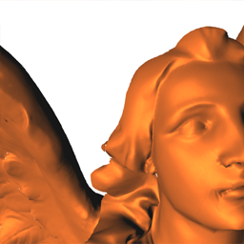
Results
Lucy
Outer hull + Normal map
Original Mesh (1.5 fps)
Our method (273 fps)

Slide 17









Performance
Automatic geometry LOD control
Bunny
Lucy

Slide 18
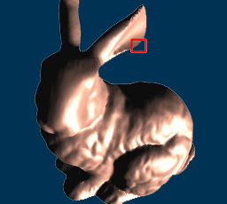
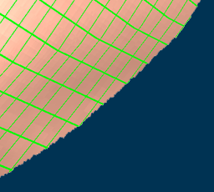

Interpolation Quality
Smooth interpolation out of coarse silhouette texture grid
Entire mesh
Silhouette texture
(green grid)
Rendering Result

Slide 19
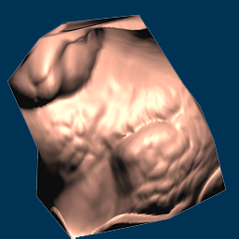
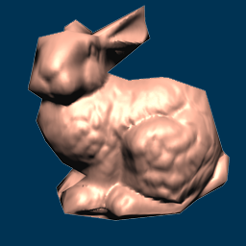
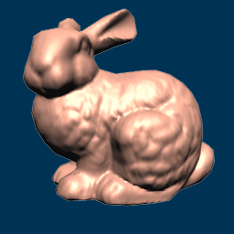
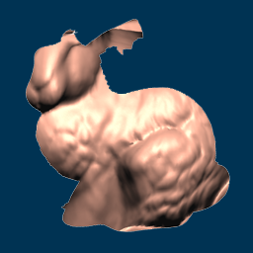
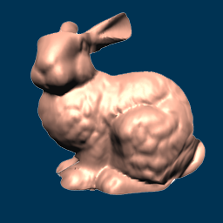
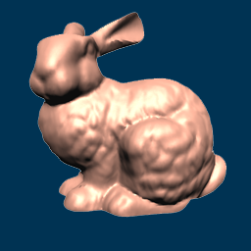
Outer Hull Resolution
Outer hull + Normal map
Our method
22 vertices
102 vertices
500 vertices

Slide 20
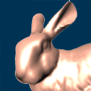
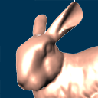
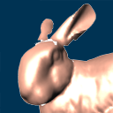


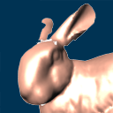
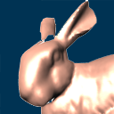

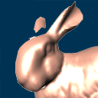
Silhouette Texture Resolution
Angular 64 16 4
Spatial
512²
128²
32²

Slide 21

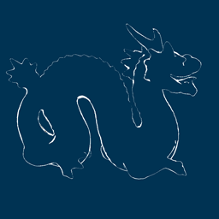

Silhouette Visualization
802 fps
753 fps
787 fps

Slide 22
Future Work
Dynamic objects
  Start with articulated figures
MIPMAP issue
Automatic geometry LOD control via texture hardware
  MIPMAP, anisotropy, etc

Slide 23
Thank you!

Slide 24
Outline
Motivation
Previous Work
Our Approach
  Visibility Function
  Silhouette Texture
Results
Conclusion
Q & A

Slide 25
Conclusions and Contributions
Reconstructing high quality, smooth silhouettes (both exterior and interior) from a silhouette texture
Compression of 4D silhouette information ->3D via a novel single lobe observation, allowing efficient hardware acceleration
Performance tuning ability for load balancing between vertex and pixel units
Automatic geometry LOD control
Additional application such as silhouette visualization

