Slide 1

A Sparse Parametric Mixture Model for BTF Compression, Editing and Rendering
Hongzhi Wu
Julie Dorsey
Holly Rushmeier
Yale University

Slide 2
Outline
Background
Challenges
Our SPMM
  Fitting Algorithm
BTF Compression, Editing & Rendering
Conclusions & Future Work

Slide 3
Background
Bidirectional Texture Function
  Lighting- and view-dependent textures (6D)
  Represents appearance of various materials
    Plastic
    Carpeting

Slide 4
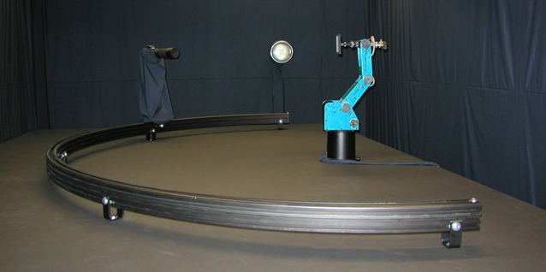
Background
Capturing a BTF
  Take pictures (spatial domain) with different lighting and view directions
camera
light
material
Sattler et al. Efficient and realistic visualization of cloth. EGSR 2003.

Slide 5
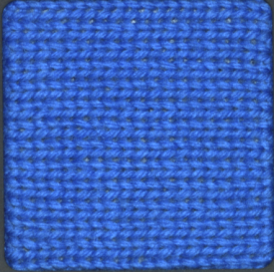
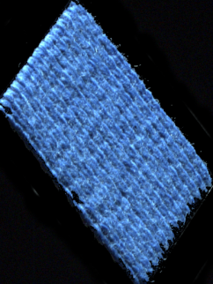

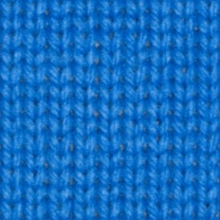
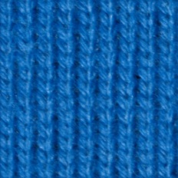
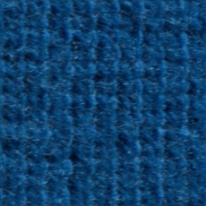
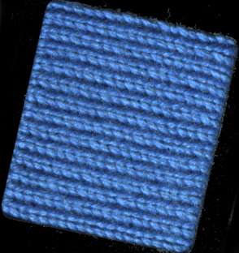
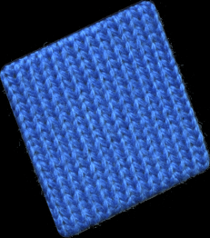
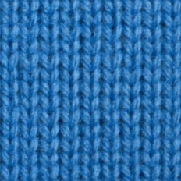
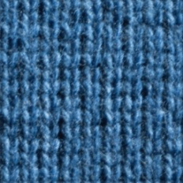
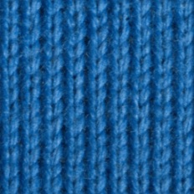
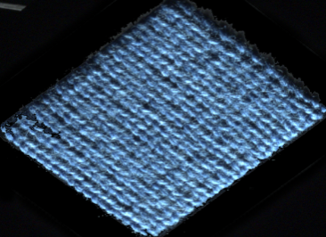
Background
Capturing a BTF
Presentation slides: Müller et al. Acquisition, synthesis and rendering of bidirectional texture functions. EG 2004.

Slide 6
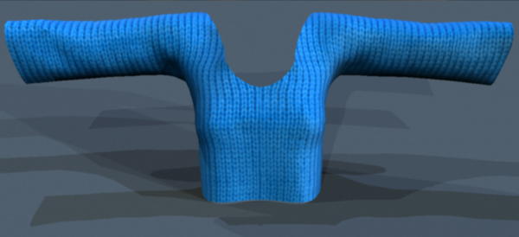
Background
Using a BTF
  Produces realistic looking rendering

Slide 7

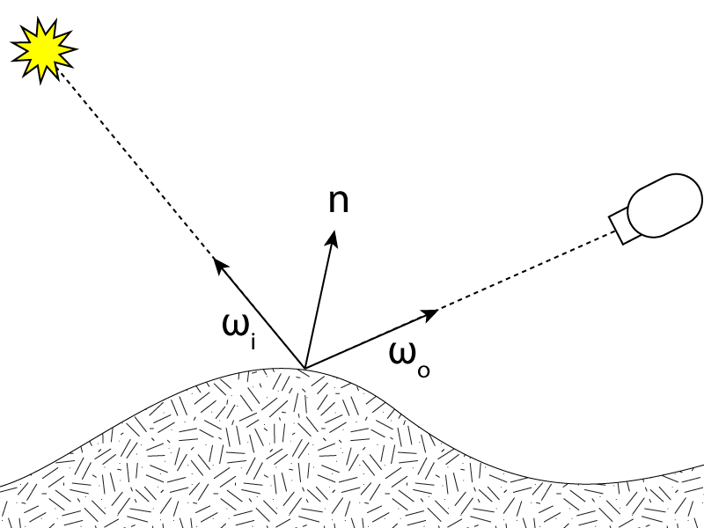
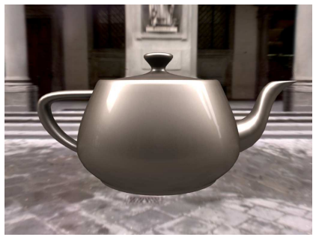
Background
Bidirectional Reflectance Distribution Function
  : 4D
Matusik et al. A Data-Driven Reflectance Model. SIGGRAPH 2003.

Slide 8
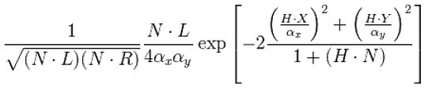
Background
  Analytical models for BRDFs
  e.g. Anisotropic Ward model
  Usually very compact
  Intuitively editable
  No analytical models for general BTFs

Slide 9
Challenges
Challenges for using BTFs
  Bulky storage (6D)
    Bonn Database: 1.2GB / LDR sample
  Lack of intuitive editing
  Lack of efficient rendering

Slide 10
Challenges
Significant research effort has been made
  But no previous work tackles all challenges at once
 | Efficient Compression | Intuitive Editing | Efficient Rendering | Accuracy/Generality
Daubert et al. Cloth Modeling & Rendering [DLHS01] / Menzel et al. Editable BTF [MG09] | √ | √ | √ | X
Kautz et al. Interactive BTF Editing [KBD07] | X | √ | X | √
Ruiter et al. Sparse Tensor Decomp [RK09] | √ | X | X | √
Havran et al. Multi-Level VQ [HFM10] | √ | X | √ | √

Slide 11
Our SPMM
A Sparse Parametric Mixture Model for a general BTF:
  Compact
  Easily editable
  Can be efficiently rendered

Slide 12

Our SPMM
A sparse linear combination of rotated analytical BRDFs
weights
parametric functions
residual function
where
rotated BRDF
  Use 7 popular models:
    Lambertian, Oren-Nayar, Blinn-Phong, Ward, Cook-Torrence, Lafortune and Ashikmin-Shirley

Slide 13
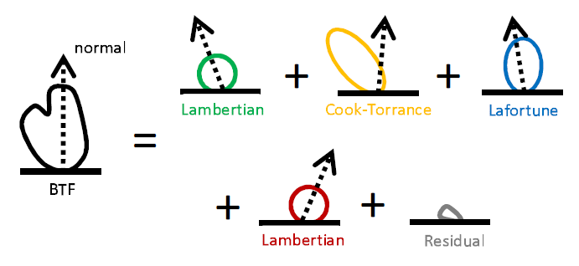
Our SPMM
  An example

Slide 14
Fitting Algorithm
Challenges for fitting SPMM to a BTF. Need to determine:
  The number of BRDFs
  The types of BRDFs
  Non-linear parameters for each BRDF
  Corresponding weights

Slide 15
Fitting Algorithm
Existing BRDF fitting algorithms cannot be used
  e.g. Levenberg-Marquardt
    Fits fixed number of lobes
    Unstable and expensive for more than 3 lobes
    Does not fit rotated BRDFs
    No way to control sparsity

Slide 16





Fitting Algorithm
  We present a Stagewise-Lasso [ZY07] based fitting algorithm to solve:
      y : a cosine-weghted BTF texel
      : a basis function
      : a dictionary
      : a weight
      : controls sparsity
approximation quality
sparsity

Slide 17

Fitting Algorithm
  The algorithm
  Init a residual function µ as y
  Find a parametric function that best correlates with µ
  Adjust its weight
    Increase by a small constant
    Or decrease if a backward-step condition is satisfied
  Update µ
  Terminate if the sparsity constraint is reached, or is close to 0; otherwise, go to 2
Please refer to our paper and [ZY07] for more details

Slide 18
Fitting Algorithm
  The algorithm
  Init a residual function µ as y
  Find a parametric function that best correlates with µ
  Adjust its weight
    Increase by a small constant
    Or decrease if a backward-step condition is satisfied
  Update µ
  Terminate if the sparsity constraint is reached, or is close to 0; otherwise, go to 2
Employ non-linear numerical optimization (IPOPT)
  Test all analytical models

Slide 19
Fitting Algorithm
Hard-thresholding on the results
Perform Non-Negative Least Square to exploit the remaining basis functions

Slide 20
BTF Compression
Expensive to run the fitting algorithm for an entire BTF
  Non-linear numerical optimization in each iteration
We exploit spatial coherence to accelerate
  k-means clustering
  Fit for samples and use the union of all basis functions as the dictionary to fit the entire cluster
Store an additional residual function for each cluster
  Improve fitting quality
  Small footprint

Slide 21
BTF Compression
Results
  Computation time 9~21 hrs
  Compression rate 1:71~1:303
  PSNR 13.16~32.42db
  Compression rates comparable to [HFM10], but we achieve considerably higher quality
See our paper for more details

Slide 22
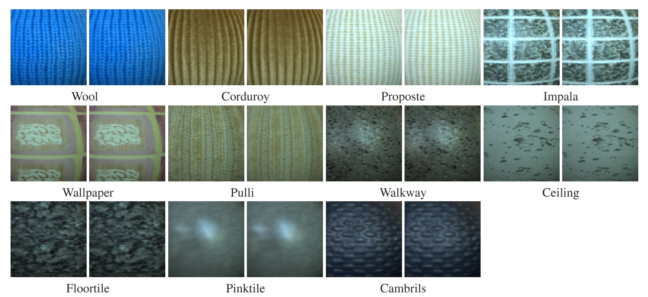
BTF Compression
Validation experiments
  Left: the original BTF
  Right: our SPMM

Slide 23
BTF Editing
Adjusting the weights
Adjusting BRDF parameters
Adjusting the Normal Distribution

Slide 24
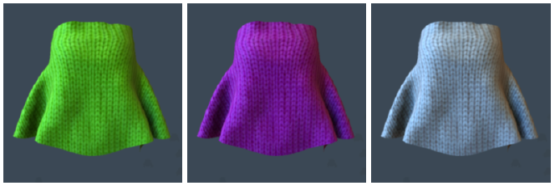
Adjusting the Weights
Adjust the intensity
Adjust the hue/saturation
Shifting the hue

Slide 25
Adjusting the Weights
Adjust the intensity
Adjust the hue/saturation
Shifting the hue
Desaturation

Slide 26
Adjusting the Weights
Classify BRDFs into non-specular/specular
  Edit separately
Classification criterion
  Lambertian, Oren-Nayar Non-specular
  All other models based on the parameter controlling the specularity

Slide 27
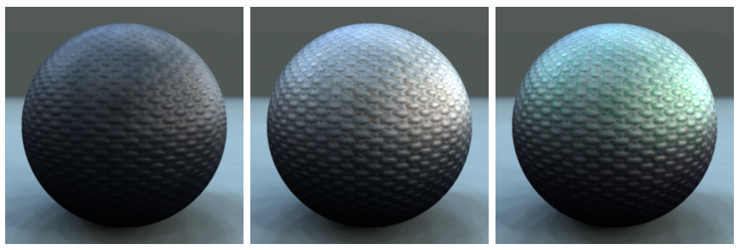
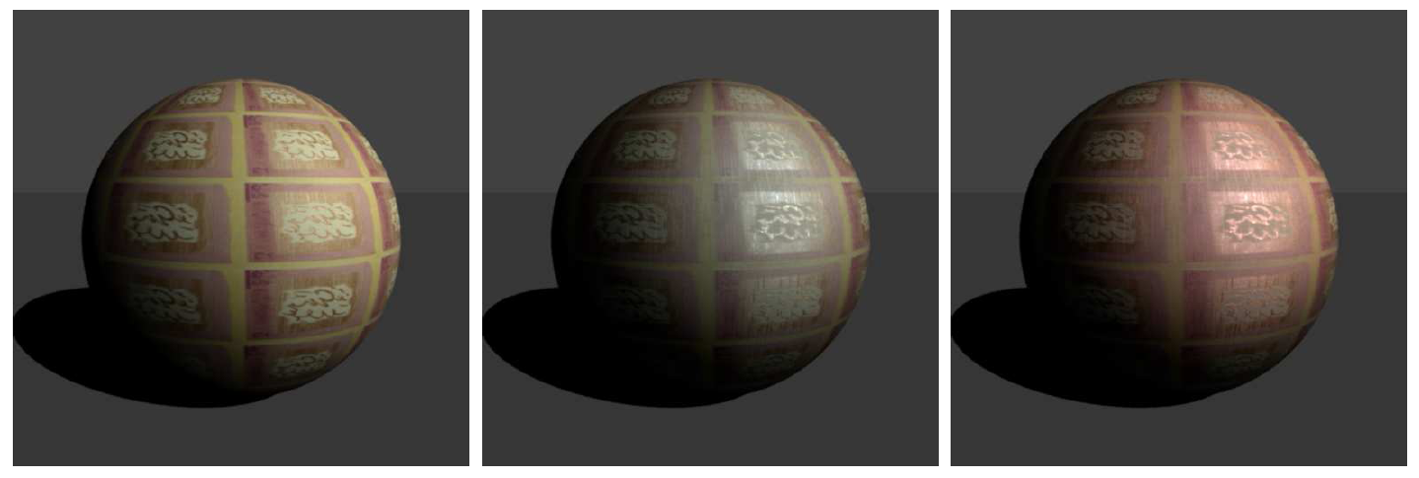
Adjusting the Weights
Original

Slide 28
Adjusting the Weights
Original
Increasing specular intensity

Slide 29
Adjusting the Weights
Original
Increasing specular intensity
Changing specular color

Slide 30
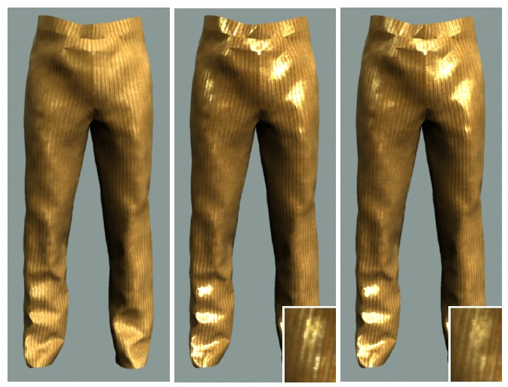
Adjusting BRDF Parameters
Original

Slide 31
Adjusting BRDF Parameters
Narrowing specular lobes
Original

Slide 32
Adjusting BRDF Parameters
Better represents specular materials
Narrowing specular lobes
Using the original format
Original

Slide 33
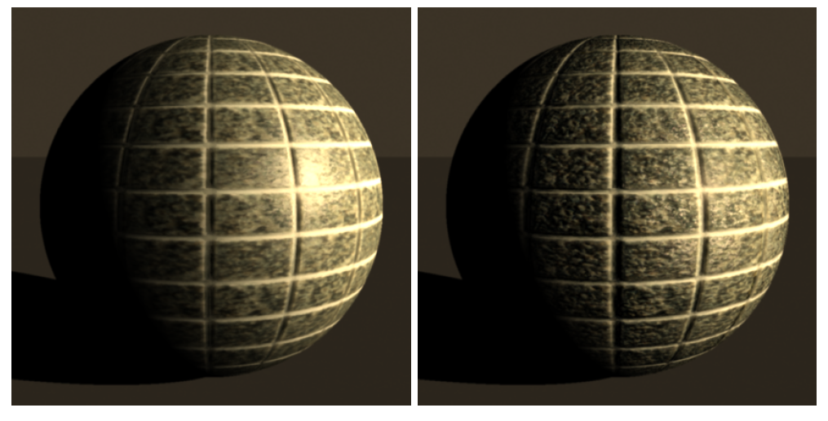
Adjusting the Normal Distribution
Original

Slide 34
Adjusting the Normal Distribution
Original
Increased roughness

Slide 35
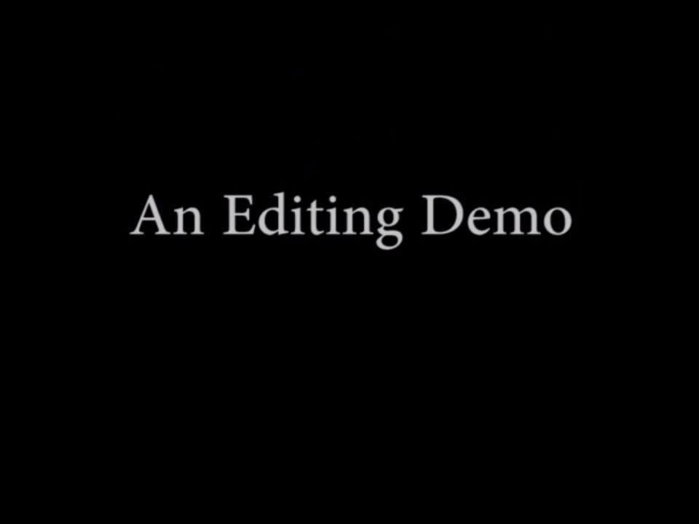
BTF Editing

Slide 36


BTF Rendering
Importance sample for a given
  Fit only BRDFs that can be analytically sampled
    Exclude Ward and Cook-Torrance
  Precompute the probability of sampling each lobe
    Based on power
  Non-specular lobes
    Sample a Lambertian lobe as an approximation
  Specular lobes
    Analytical importance sampling

Slide 37
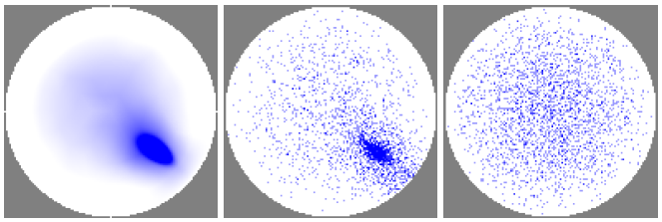
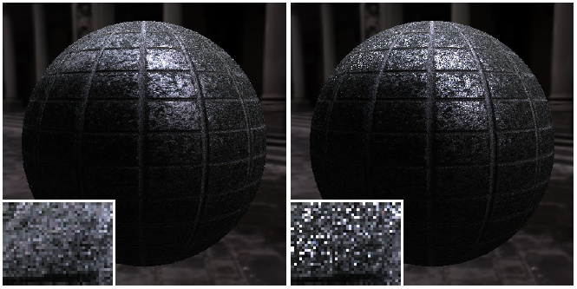
BTF Rendering
BTF intensity distribution
Our sampling
Cosine-weighted sampling
Our result
Equal-time rendering using cosine-weighted sampling

Slide 38
Conclusions & Future Work
We present a compact, easily editable and efficiently renderable representation for general BTFs
We also present a Stagewise-Lasso-based fitting algorithm
  The first algorithm for fitting multiple rotated analytical BRDFs of different types
  Could be useful for general inverse procedural modeling
Future Work
  Implement SPMM on GPU
  Experiment with more analytical functions

Slide 39
Acknowledgements
Yale Computer Graphics Group
University of Bonn & PSA Peugeot Citreon
  BTF databases
Huan Wang (Yale)
  Discussions on Lasso
Soloumon Boulos (Stanford) & Jan Kautz (UCL)
  3D models

Slide 40
謝謝
Questions?
Email: hongzhi.wu@gmail.com
Web: http://graphics.cs.yale.edu/hongzhi/

Slide 41
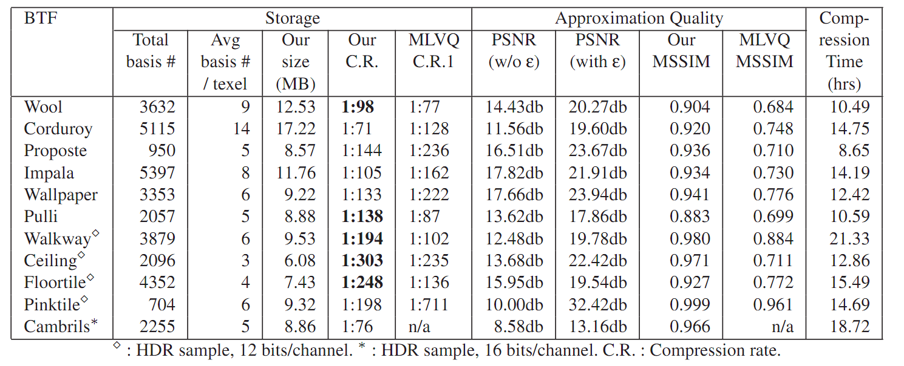
Back-up slides

Slide 42
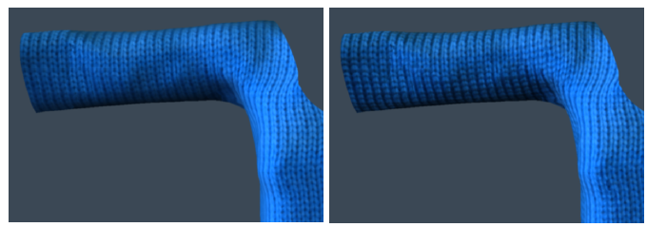
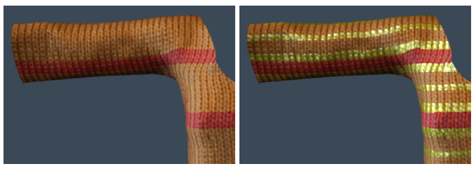
Back-up slides

Slide 43
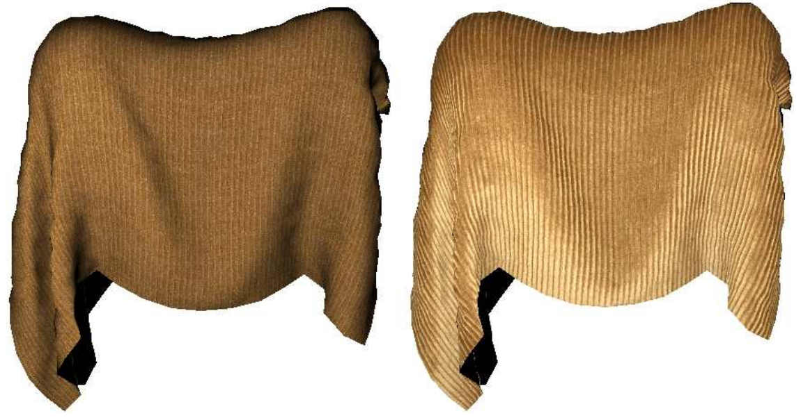
Back-up slides
Texture Map
BTF
Müller et al. Acquisition, synthesis and rendering of bidirectional texture functions. EG 2004.

Slide 44
Back-up slides
A sparse linear combination of rotated analytical BRDFs
  Sparse Compact
  Linear Combination, Rotated Generality
  Analytical BRDFs Compact, Editable & Efficiently Renderable
weights
parametric functions
residual function
where
rotated BRDF
  Use 7 popular models:
    Lambertian, Oren-Nayar, Blinn-Phong, Ward, Cook-Torrence, Lafortune and Ashikmin-Shirley

Slide 45


Back-up slides
An approximate heterogeneous microfacet-based model
  Each represents a reflectance function of a microfacet oriented towards

