Slide 1
图像拼接
彭思达
计算摄影学第八讲

Slide 2
Panorama
Notes:
Q：原理是什么？

Slide 3
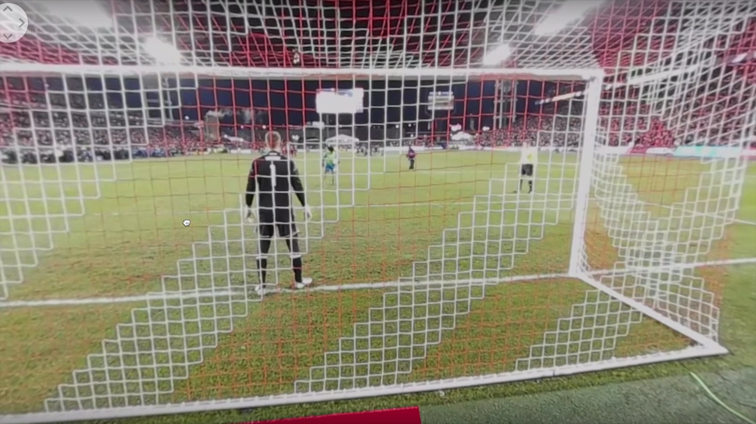
360 VR

Slide 4
360 VR
360 Camera
GoPro odyssey
VR Glasses
Image stitching

Slide 5
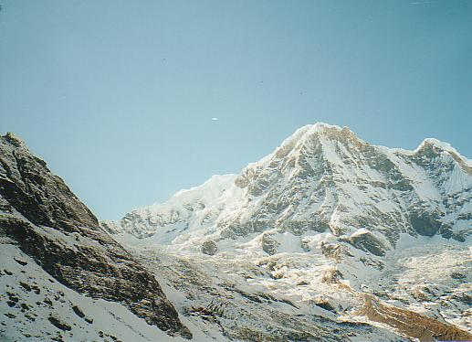
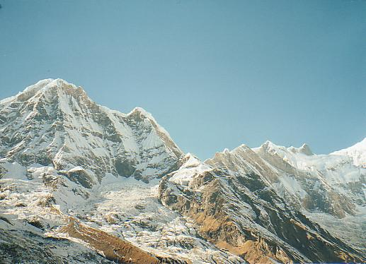
How to combine two images?

Slide 6
How to combine two images?
What is image warping?
How to compute it?

Slide 7
Today
Image Warping
Image Stitching

Slide 8
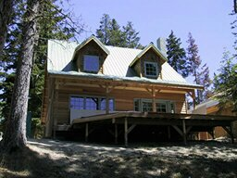
Image Warping
image filtering: change intensity of image
image warping: change shape of image
f
g
f
g

Slide 9
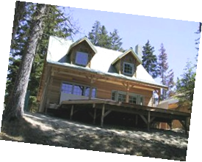
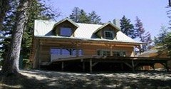
Parametric (global) warping
T
p’ = (x’,y’)
p = (x,y)
Transformation T is a coordinate transformation:
p’ = T(p)
Examples:
translation
rotation
aspect

Slide 10
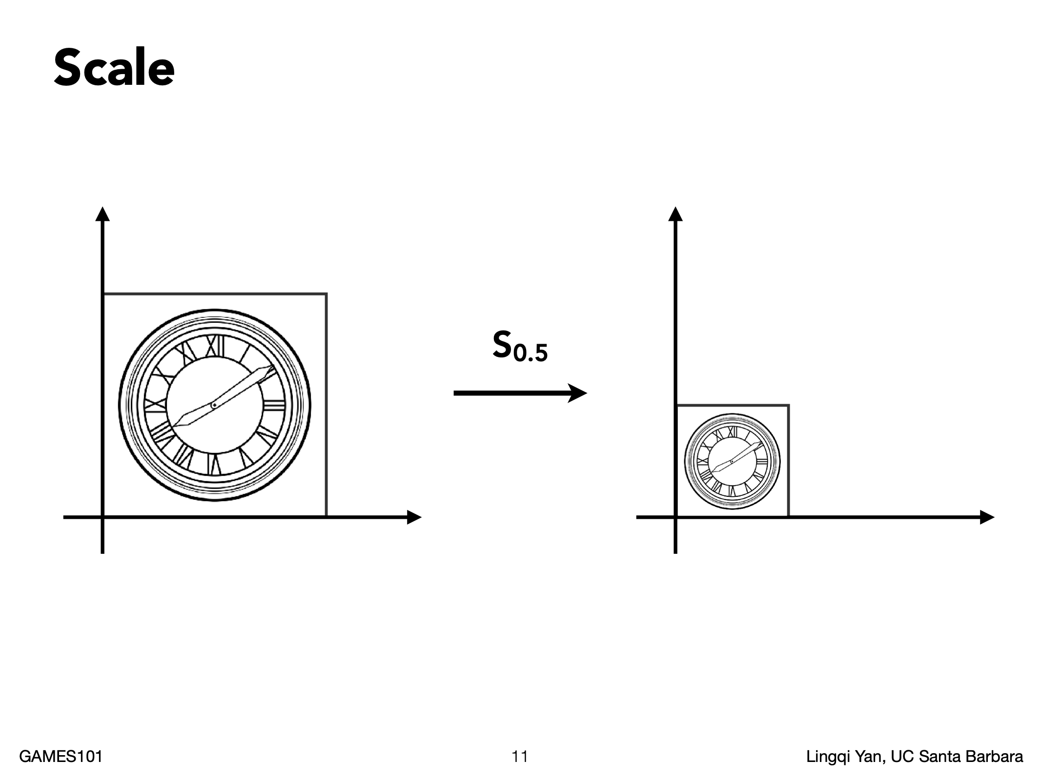

Slide 11
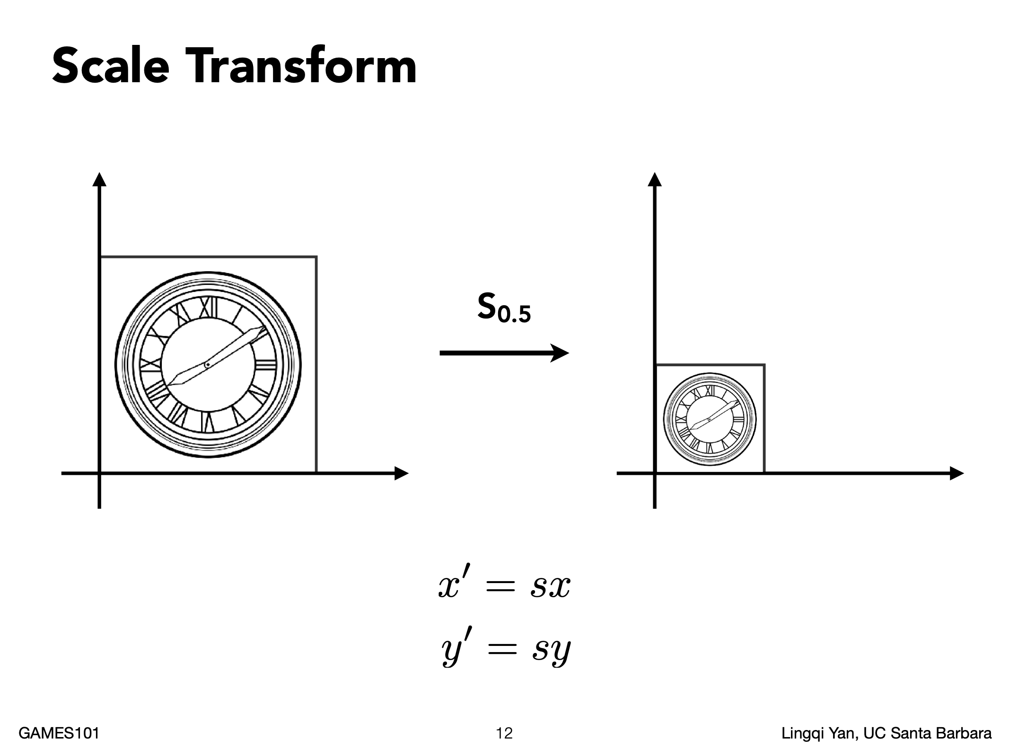

Slide 12
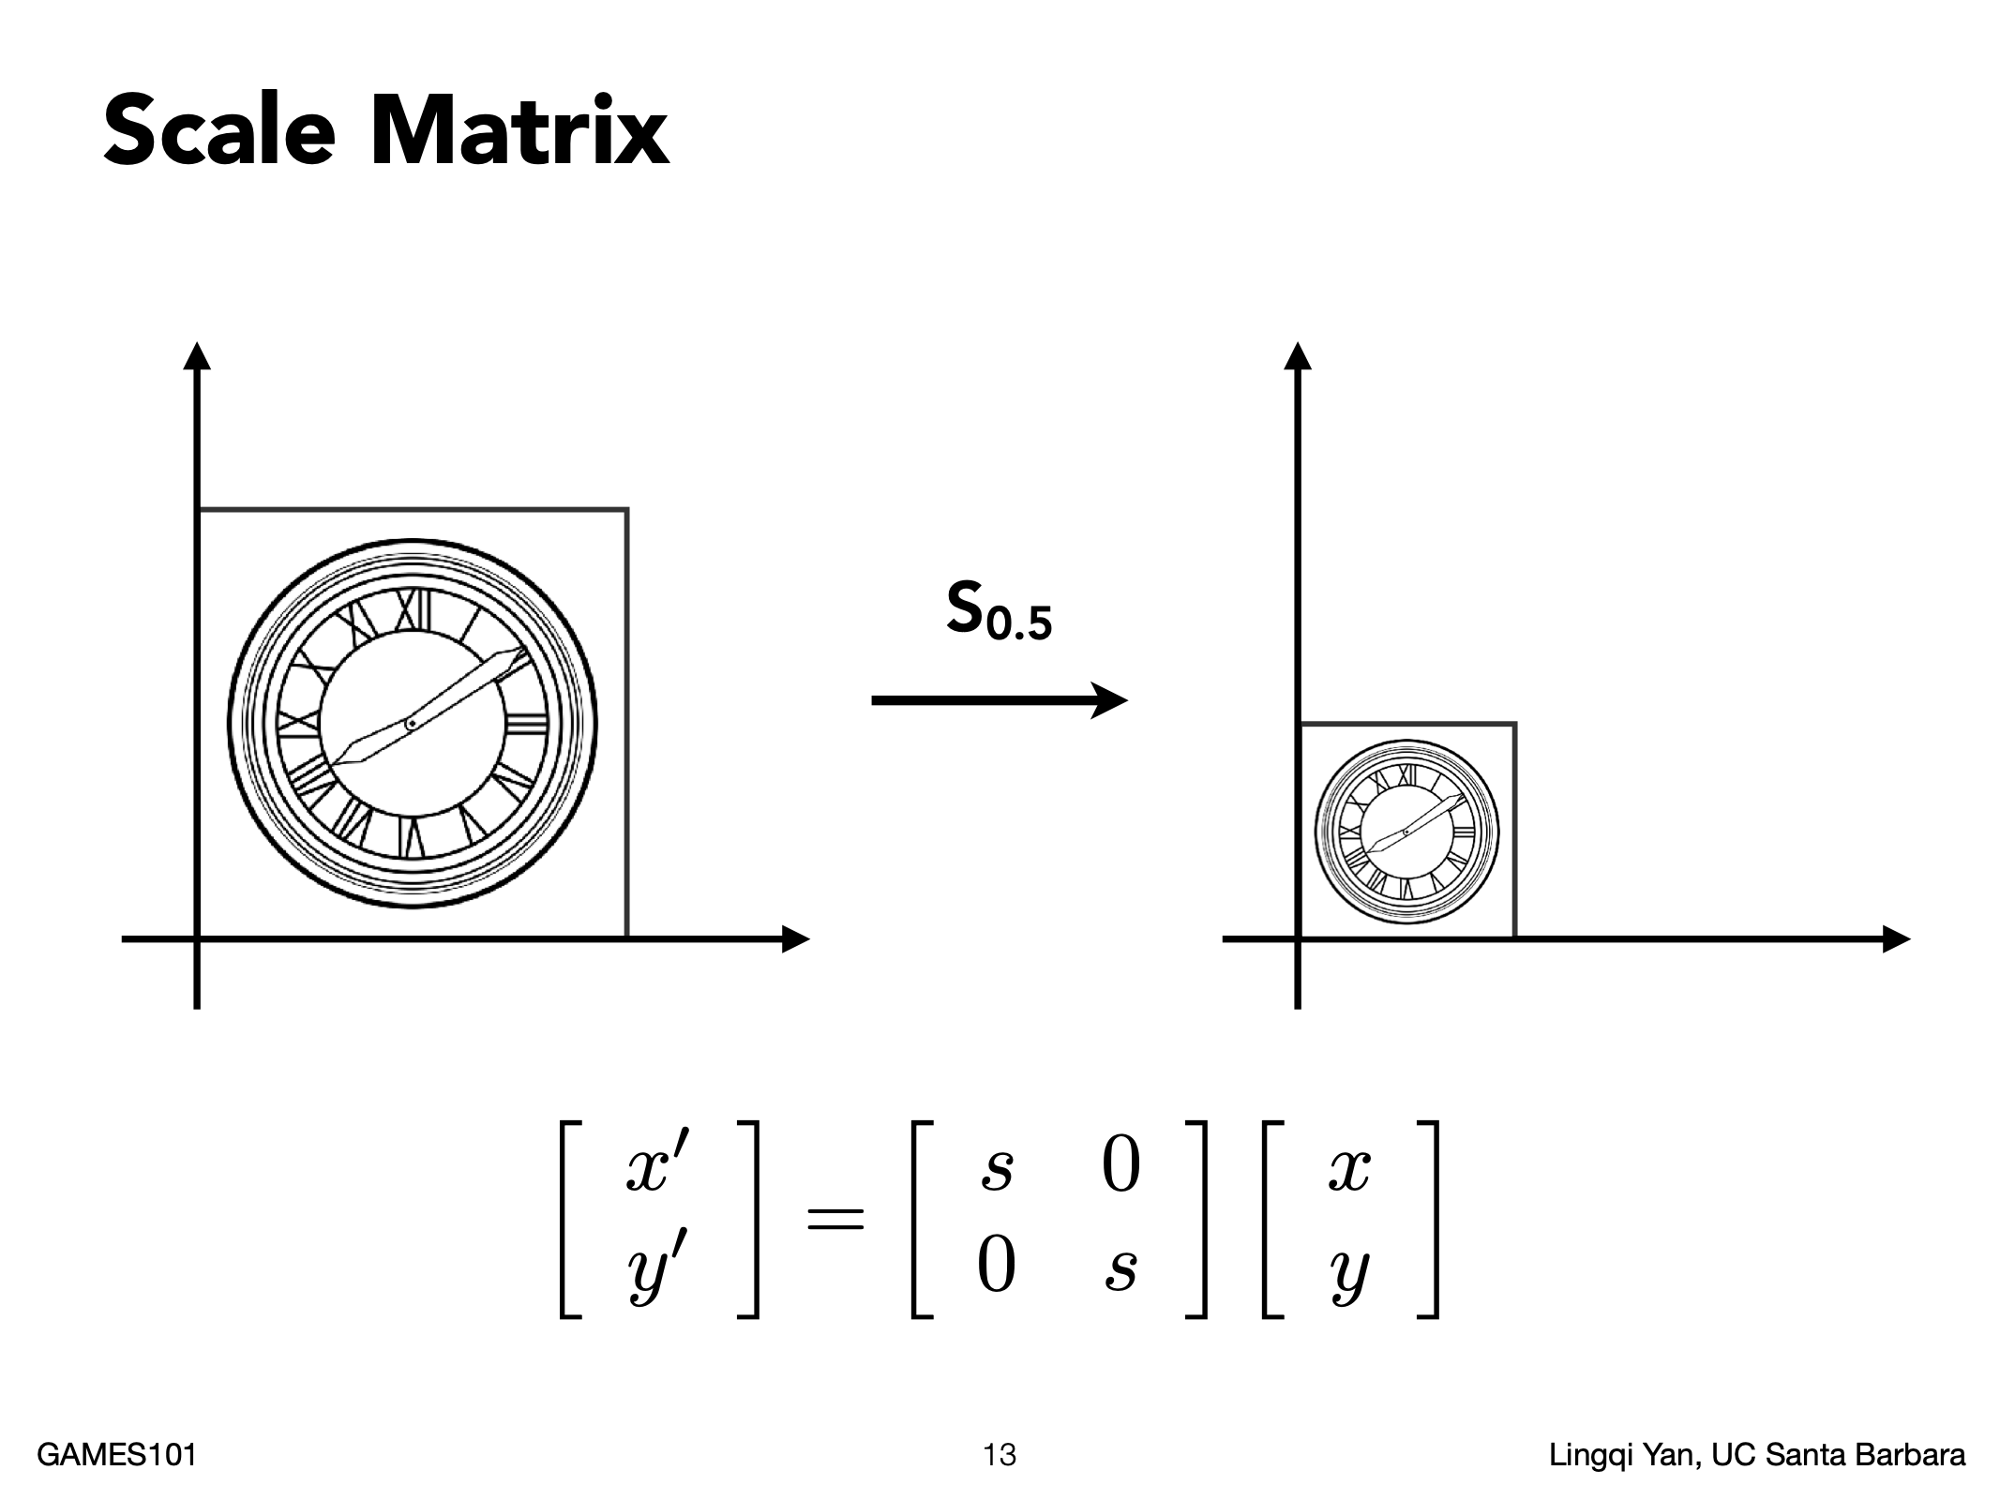

Slide 13
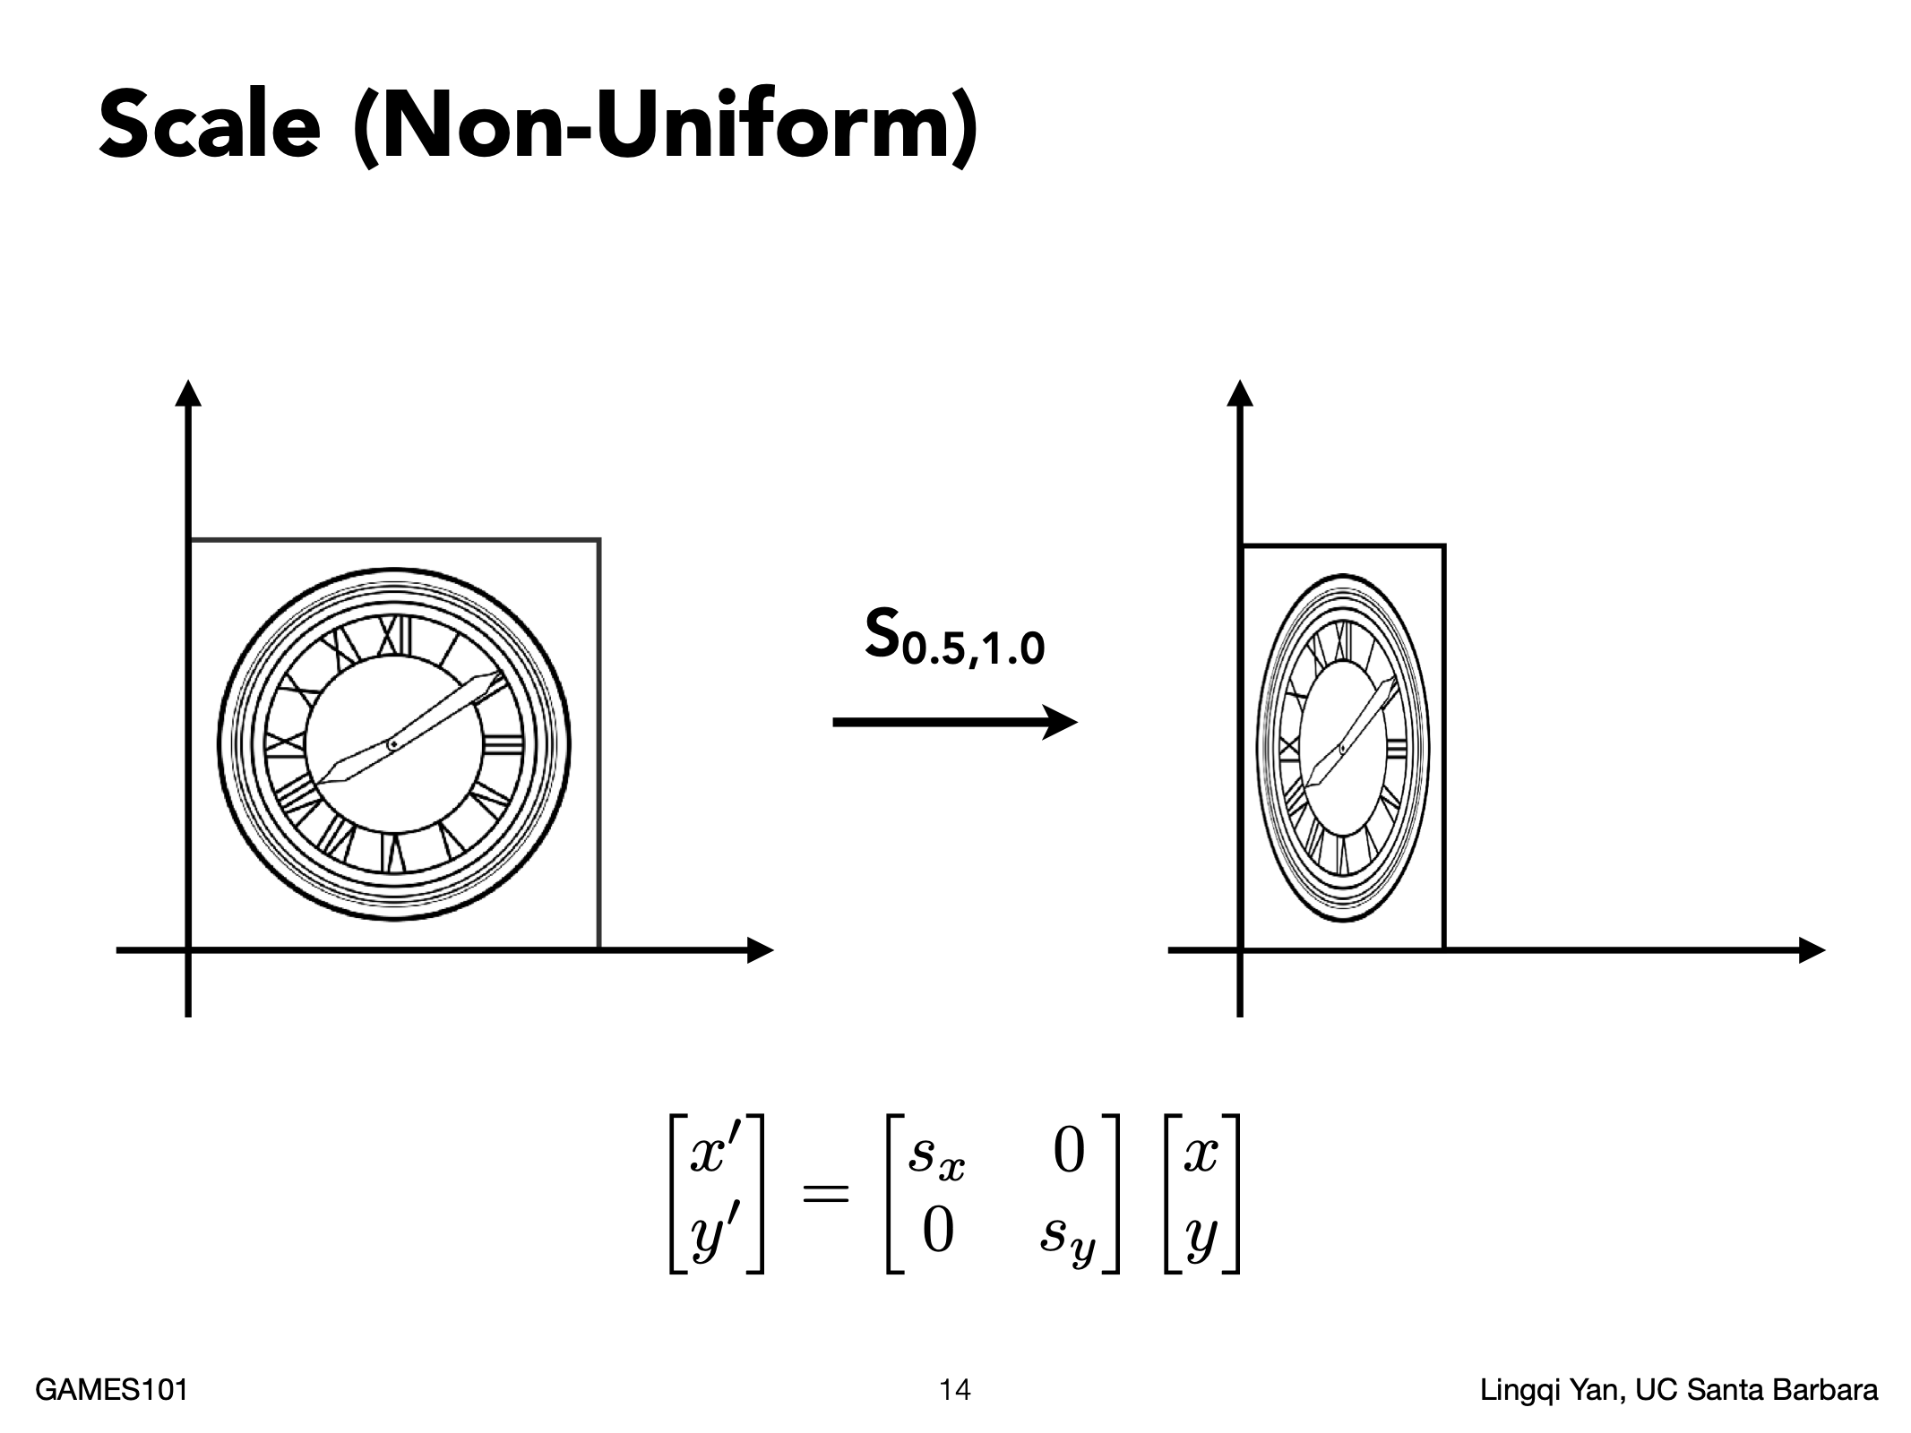

Slide 14
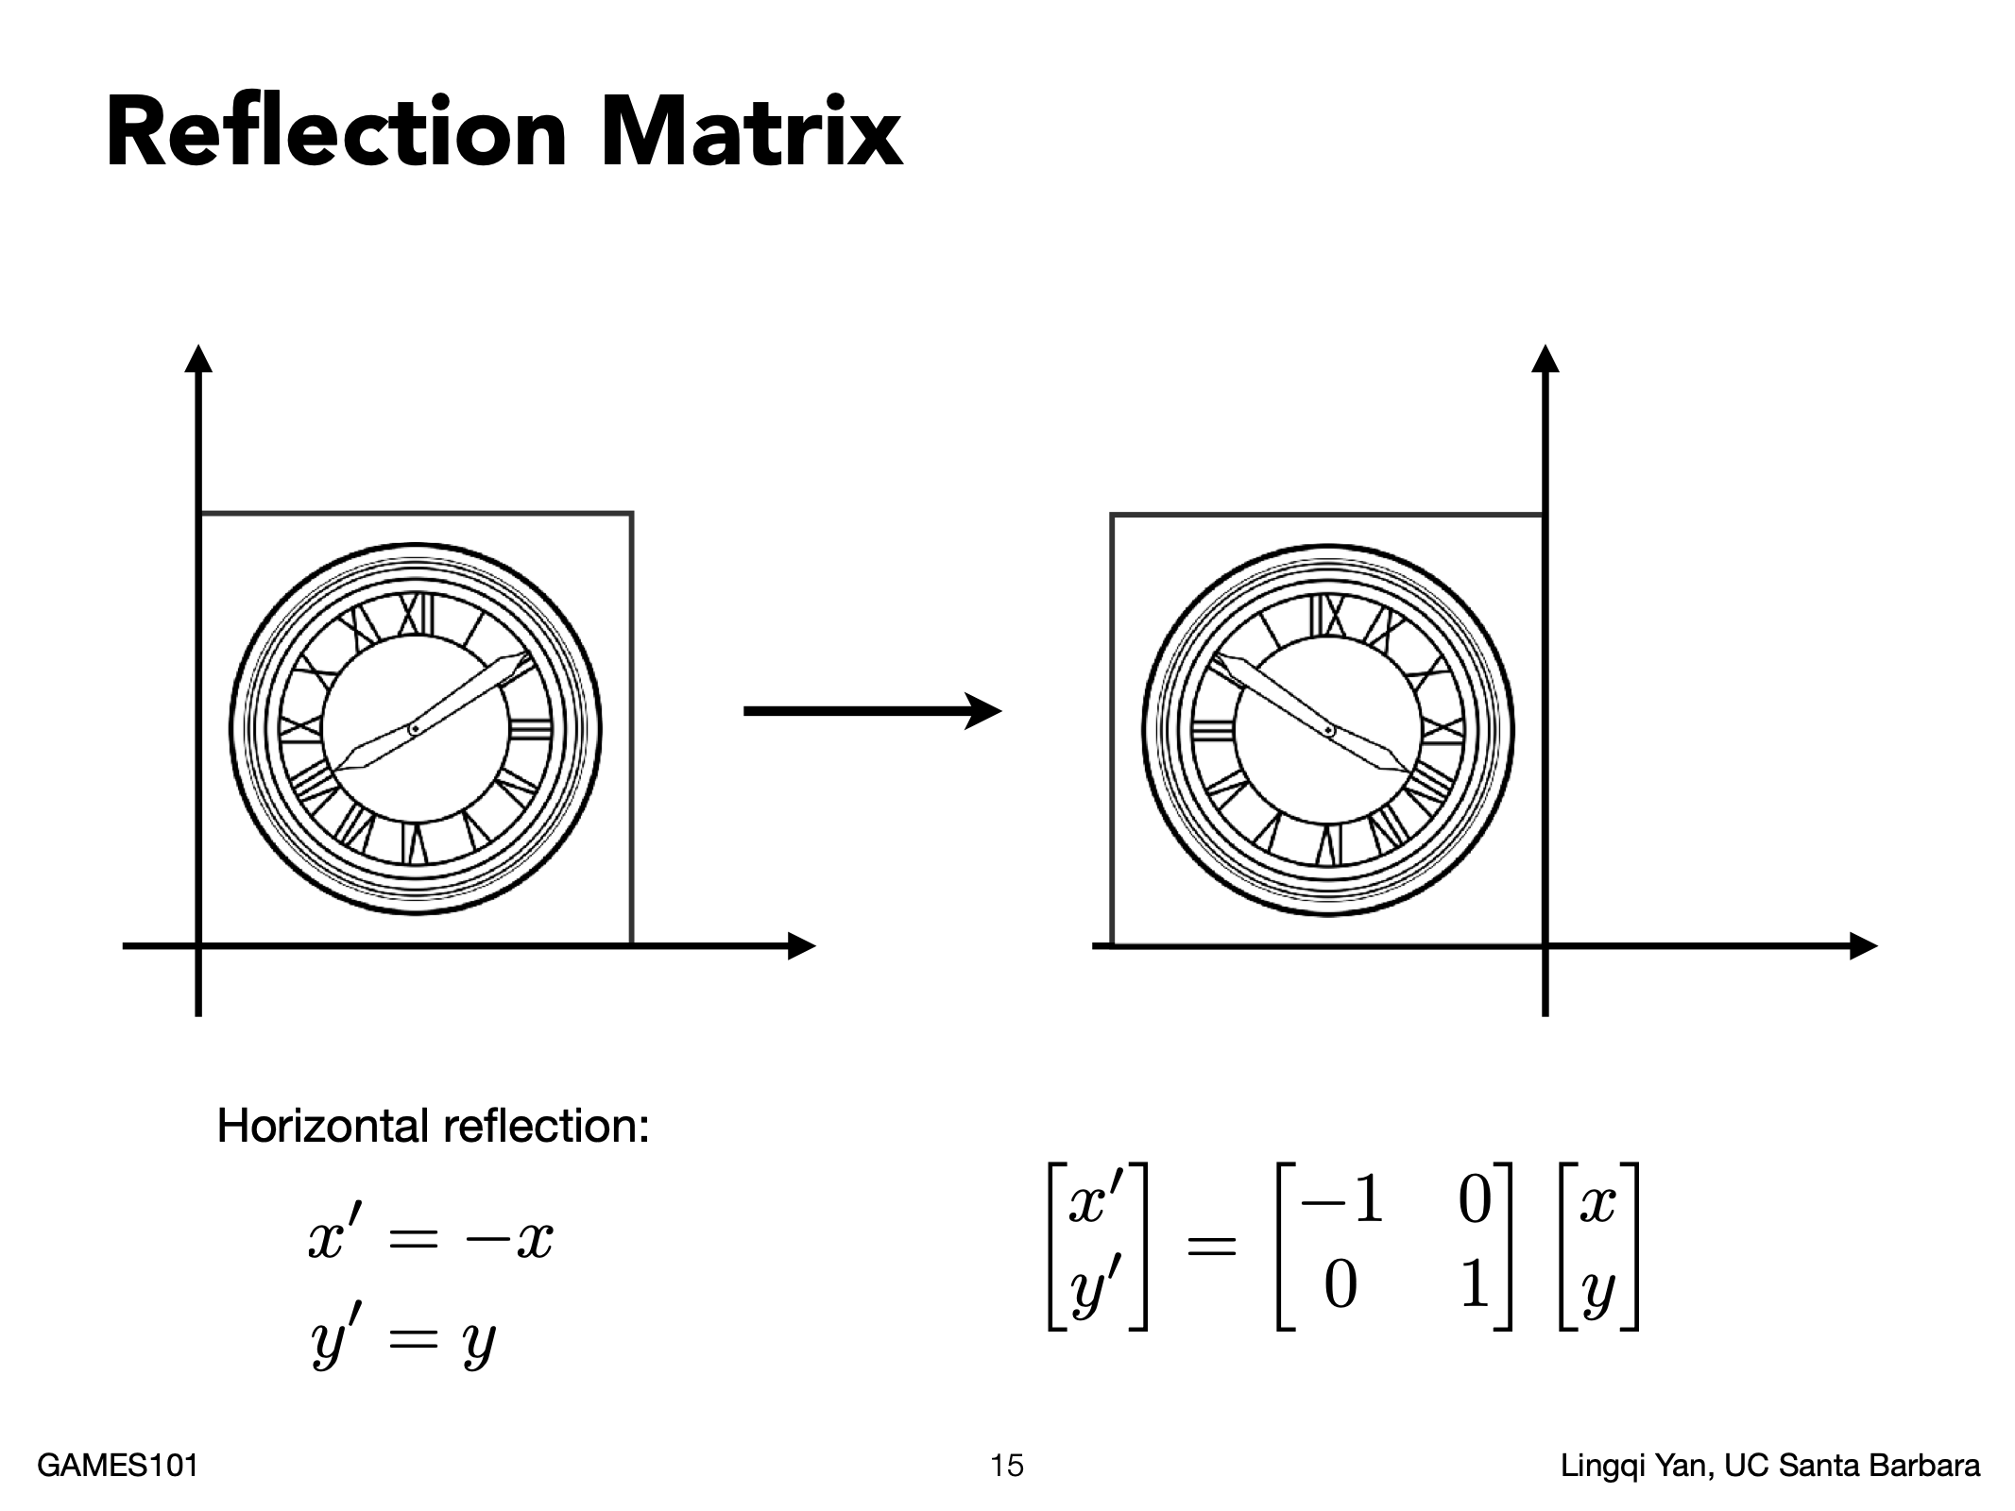

Slide 15
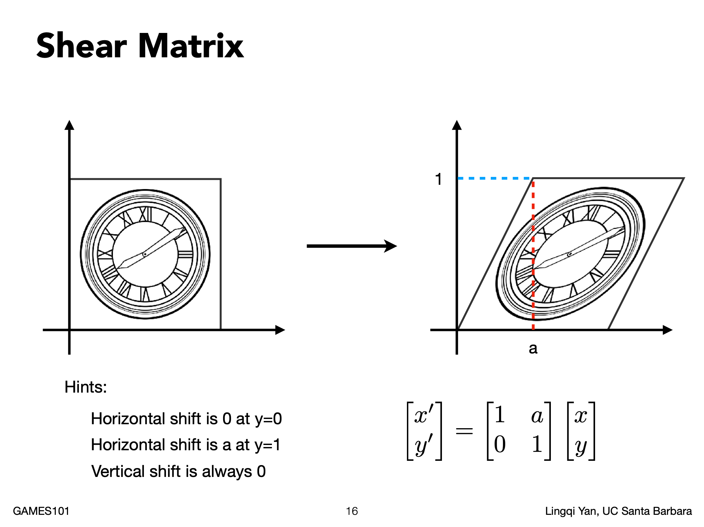

Slide 16
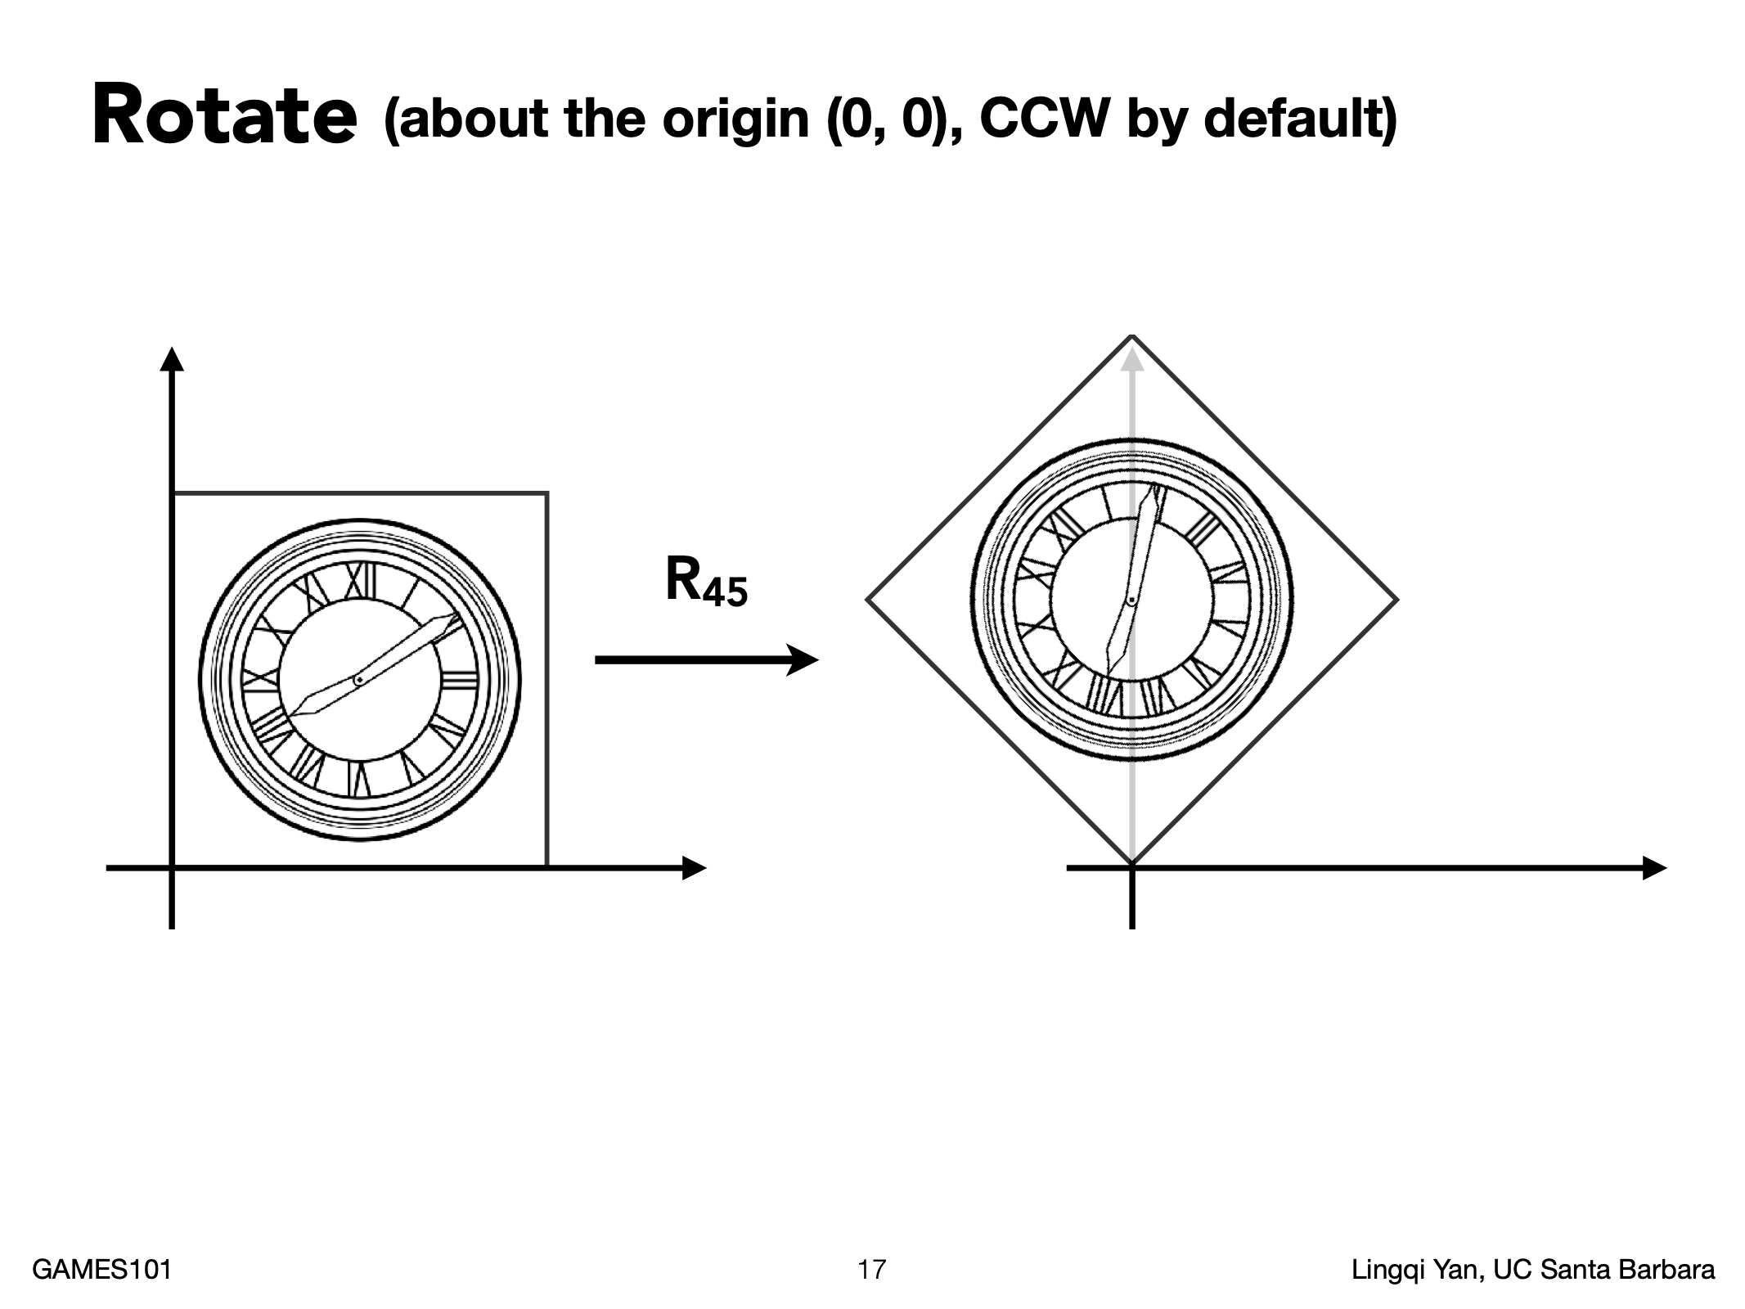

Slide 17
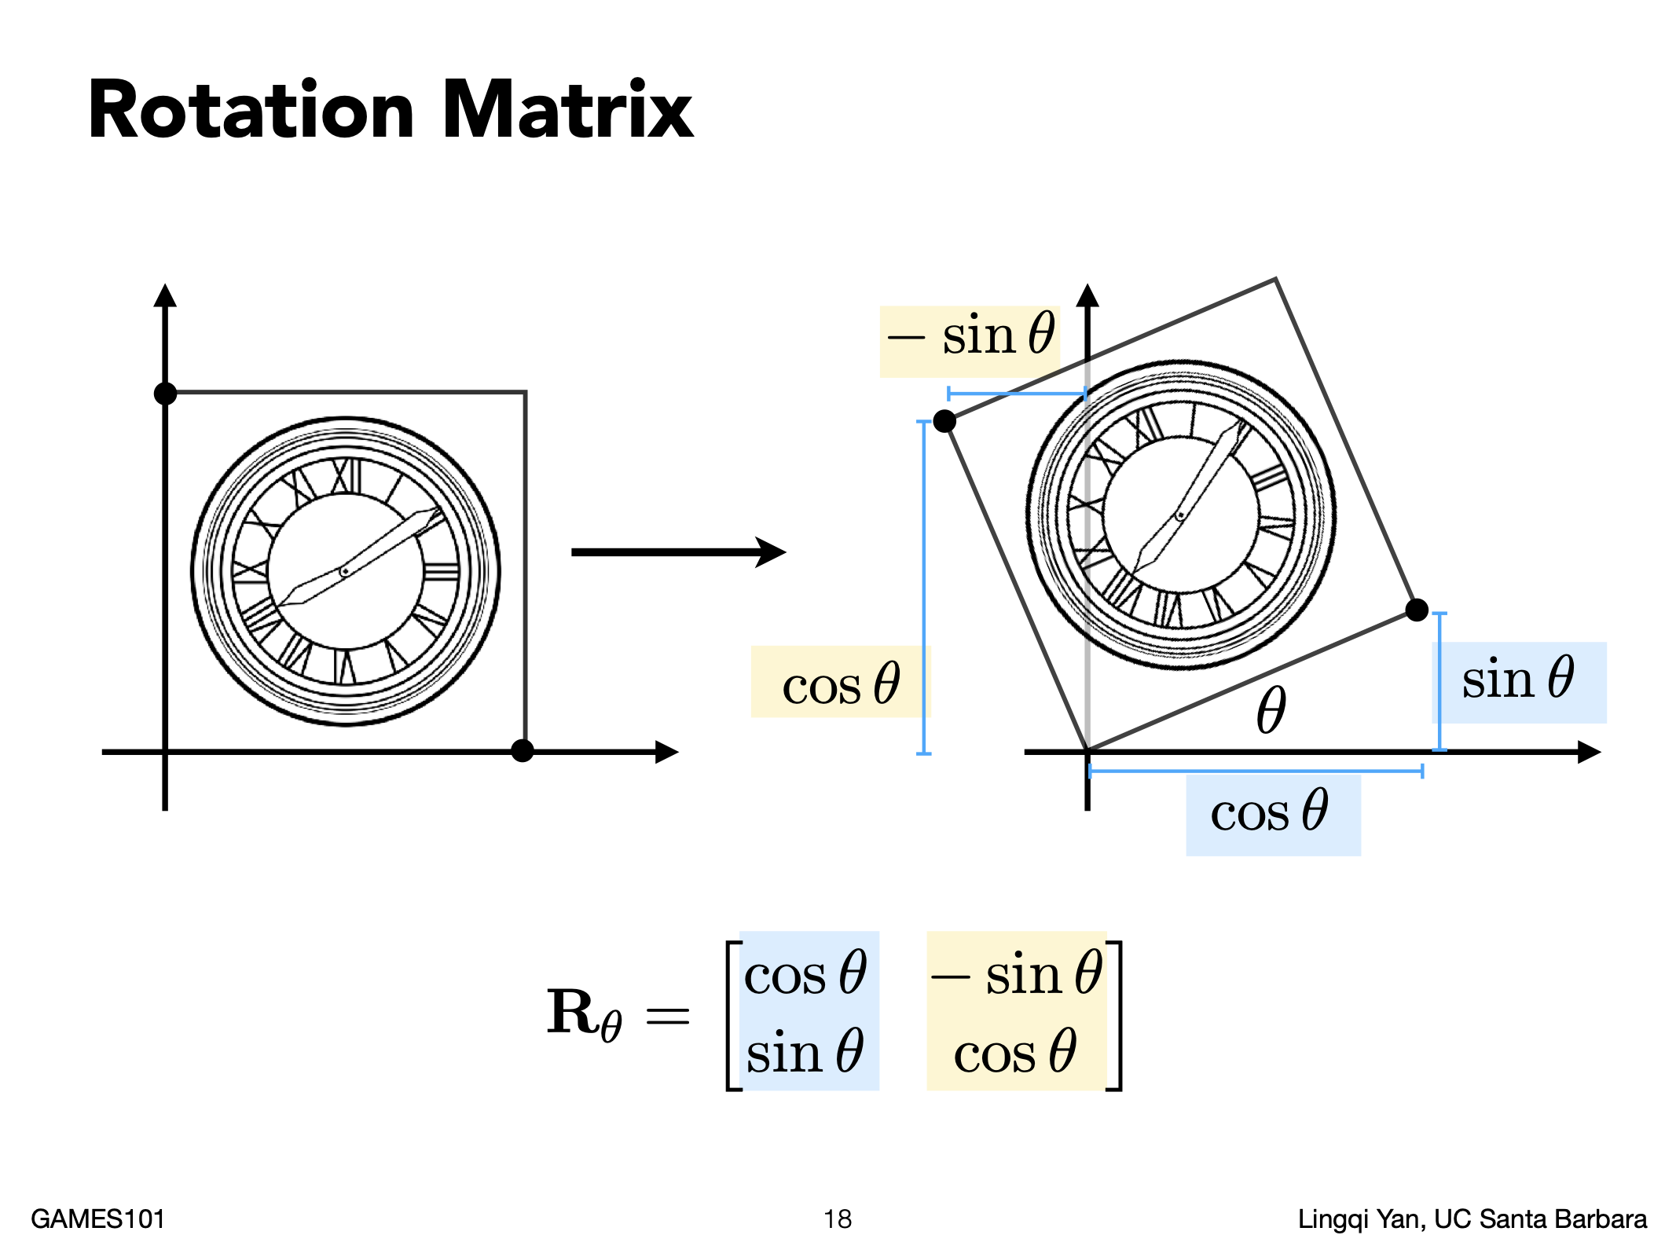

Slide 18
Columns of M are new coordinates of the standard basis after transformation

Slide 19
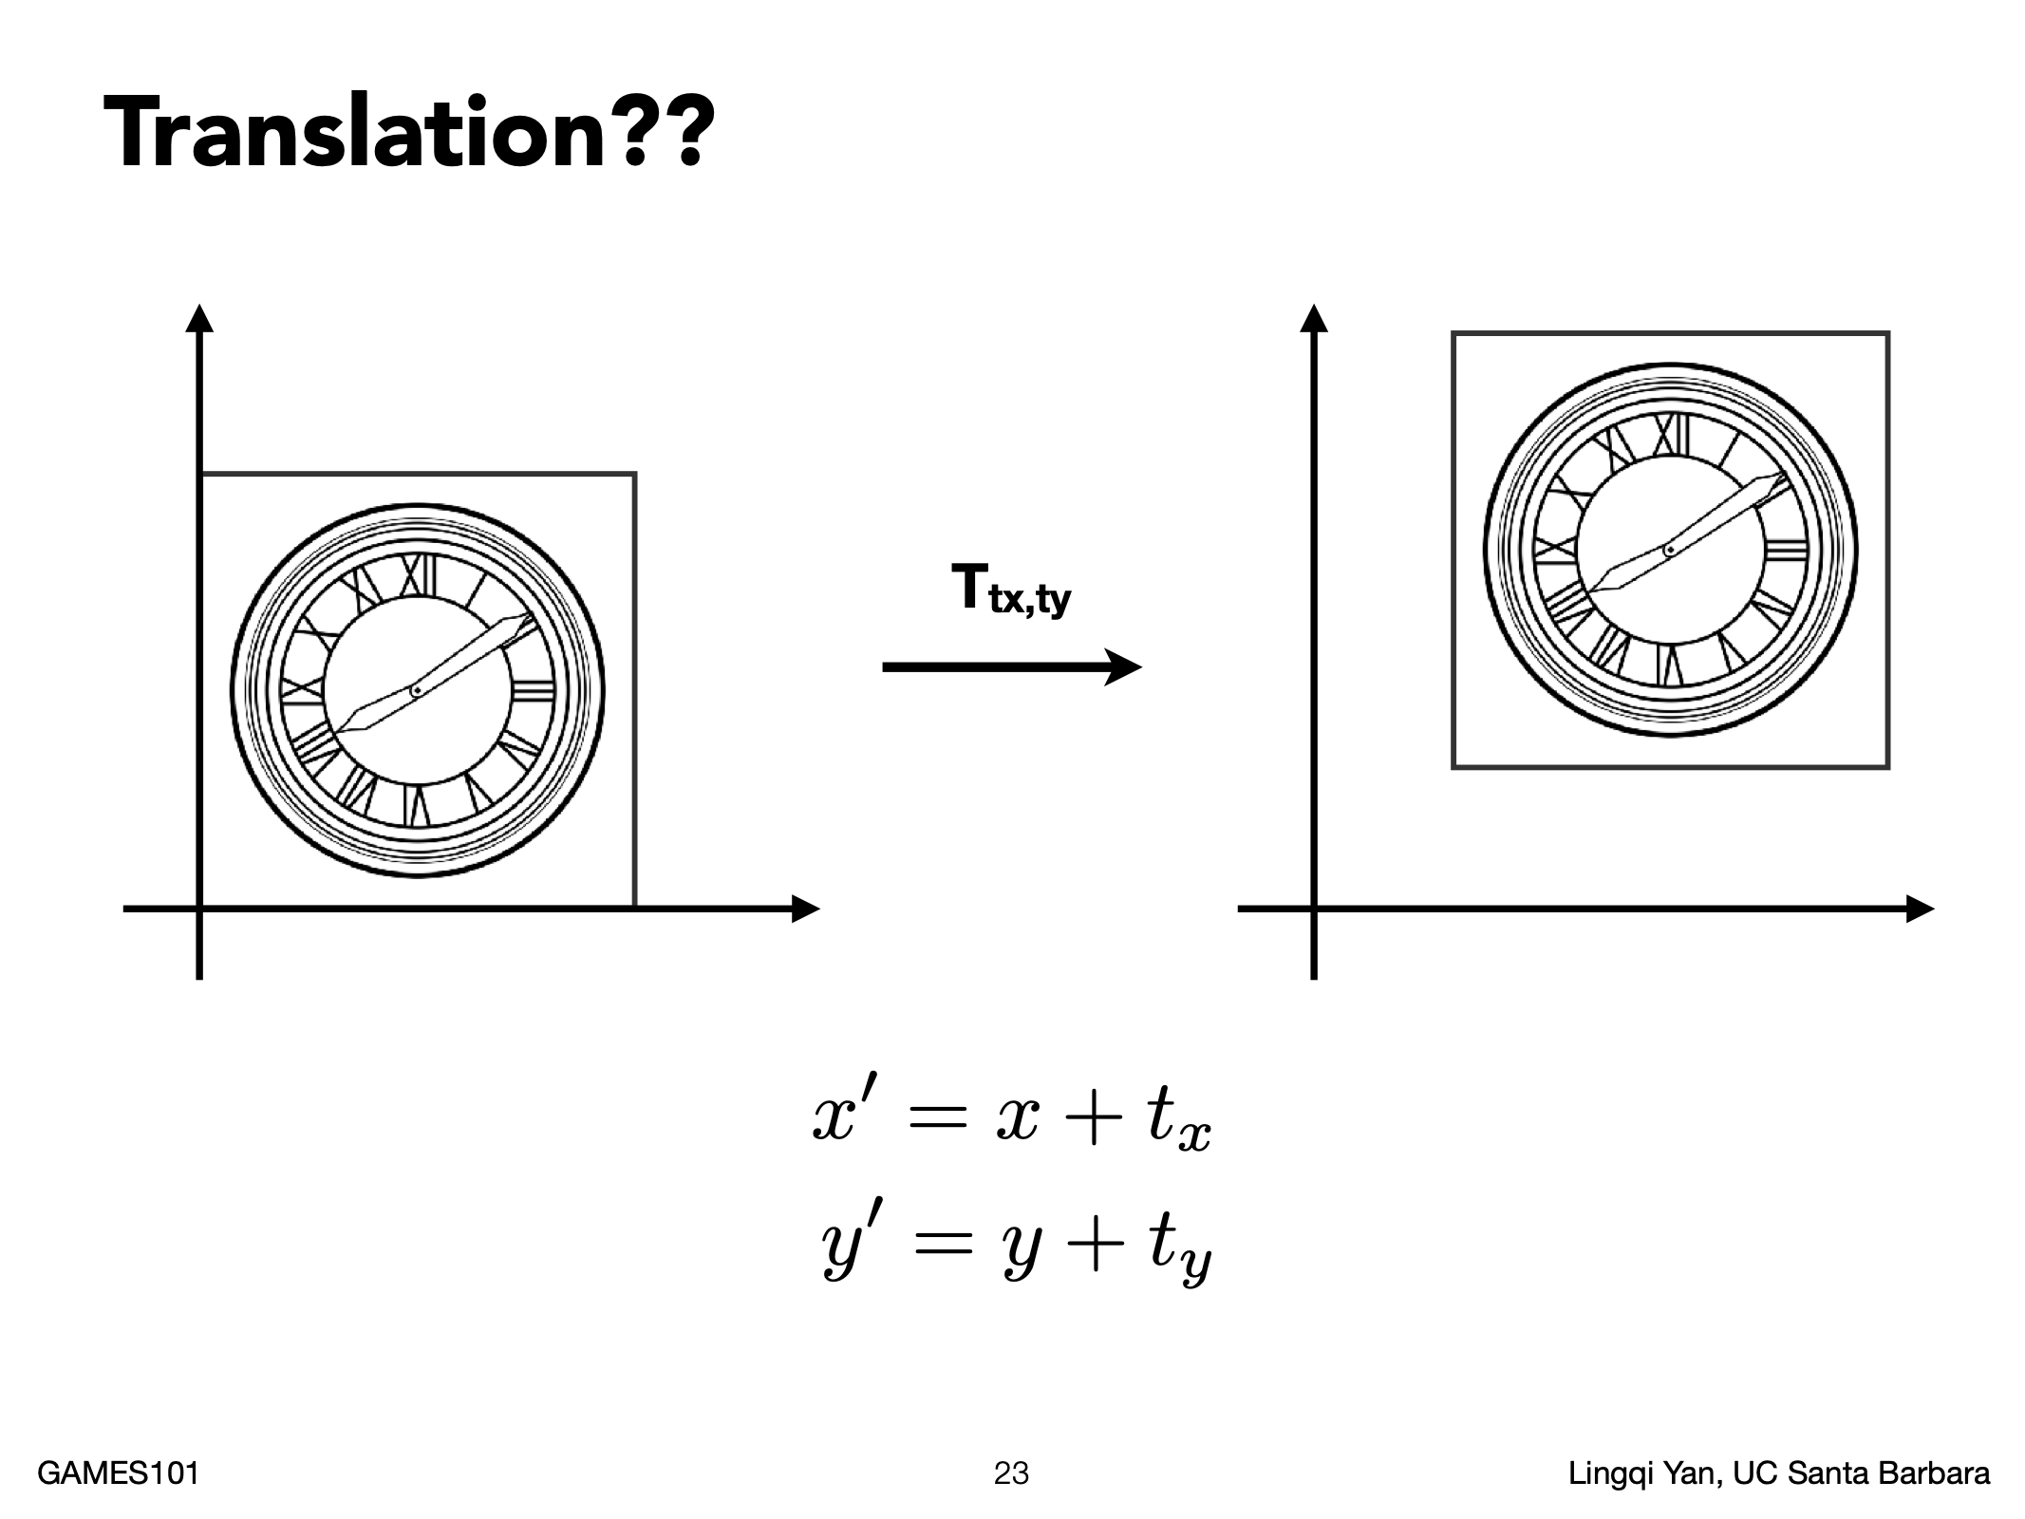
Is translation linear transformation?

Slide 20
How to write it as matrix-vector multiplication?

Slide 21
齐次坐标
any transformation represented by a 3x3 matrix with last row [ 0 0 1 ] we call an affine transformation

Slide 22
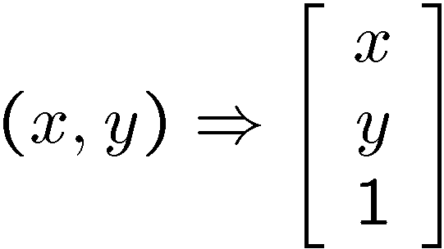
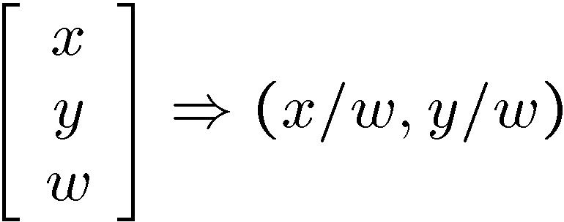
Homogeneous coordinates
Converting to homogeneous coordinates
Converting from homogeneous to Cartesian
Homogeneous coordinates are invariant to scaling
Each point has an infinite set of homogeneous coordinates
Notes:
Append coordinate with value 1; proportional coordinate system

Slide 23
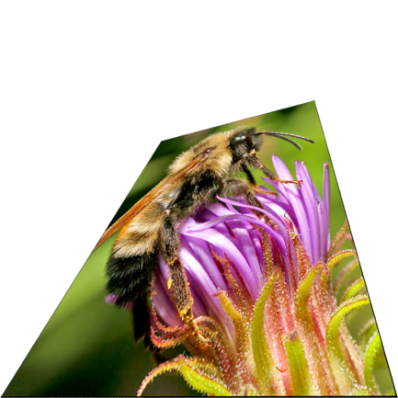

Projective Transformation (Homography)

Slide 24
Projective Transformation (Homography)
Maybe nonzero
We usually constrain the length of the vector [h₀₀ h₀₁ … h₂₂] to be 1, which means the degree of freedom is 8

Slide 25
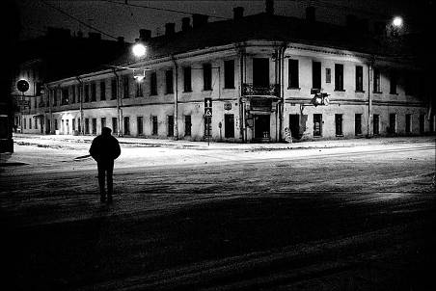
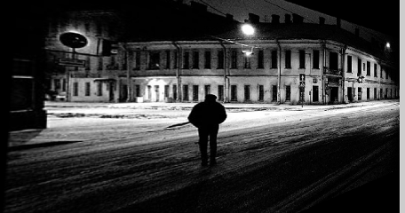
Projective Transformation (Homography)
In what cases is the transformation of two images a homography?
Camera rotated with camera center fixed
This is the reason why we are not allowed to move when taking panorama

Slide 26
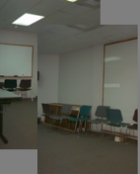
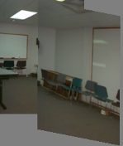
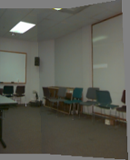
Summary of 2D transformations
Translation
Affine
Projective
2 unknowns
6 unknowns
8 unknowns

Slide 27
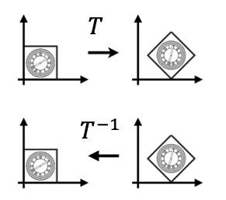



Inverse Transform
$$T^{−1}$$
$$T^{−1}$$
$$T$$
is the inverse of transform in both a matrix and geometric sense

Slide 28
Implementing image warping
Given a coordinate transform (x’,y’) = T(x,y) and a source image f(x,y), how do we compute an transformed image g(x’,y’) = f(T(x,y))?
y
y’
x
x’
f(x,y)
g(x’,y’)

Slide 29
Forward Warping
Send each pixel f(x) to its corresponding location (x’,y’) = T(x,y) in g(x’,y’)
y
T(x,y)
y’
x
x’
f(x,y)
g(x’,y’)

Slide 30
Forward Warping
What if pixel lands “between” pixels?

Slide 31
Inverse Warping
Get each pixel g(x’,y’) from its corresponding location (x,y) = T⁻¹(x,y) in f(x,y)
y
T⁻¹(x,y)
y’
x
x’
f(x,y)
g(x’,y’)

Slide 32
Inverse Warping
What if pixel lands “between” pixels?
Answer: interpolate color values from neighboring pixels

Slide 33
Interpolation
Nearest neighbor
Copies the color of the pixel with the closest integer coordinate

Slide 34
Interpolation
Weighted sum of four neighboring pixels

Slide 35
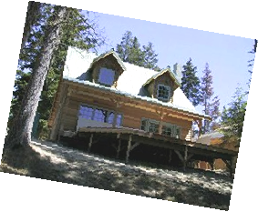
Interpolation
Possible interpolation filters:
  nearest neighbor
  bilinear
  bicubic
  sinc

Slide 36
Interpolation

Slide 37
Nearest-neighbor interpolation
Not continuous
Not smooth

Slide 38
Linear interpolation
Continous
Not smooth
Notes:
两点确定一条直线

Slide 39
Cubic interpolation
Continous
Smooth
For each interval:
$$y=ax^{3}+bx^{2}+cx+d$$
Notes:
多项式拟合
为什么三次：

Slide 43
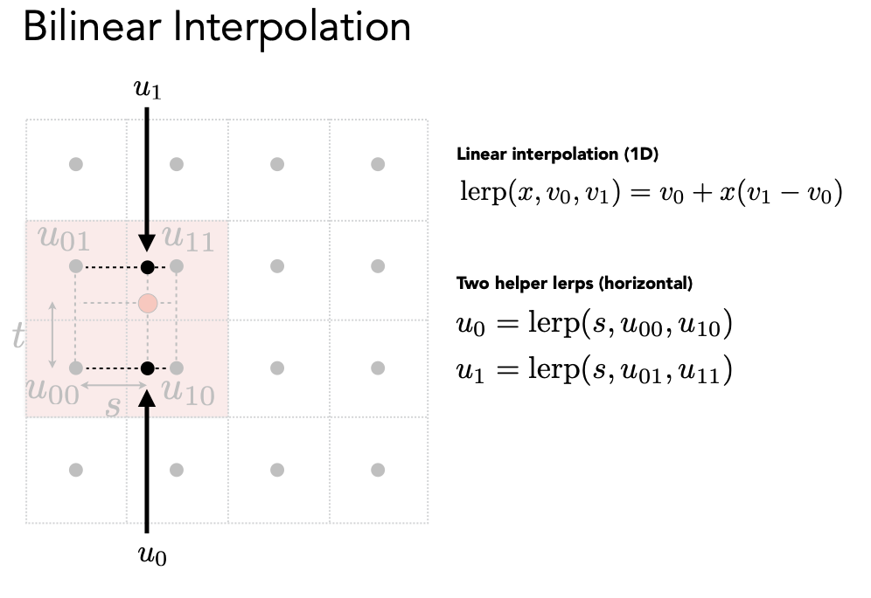

Slide 45
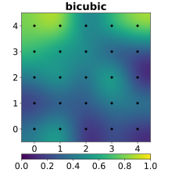
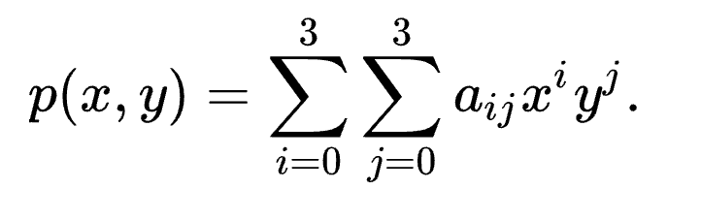
Bicubic Interpolation

Slide 46
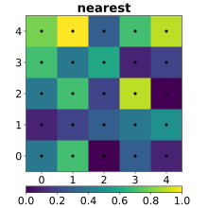
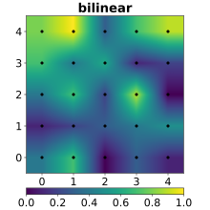
Comparison

Slide 47
Comparison
Generally bilinear is good enough

Slide 48
Questions?

Slide 49
Today
Image Warping.
Image Stitching.

Slide 50
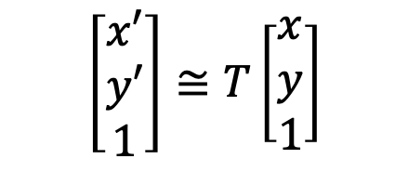
How to compute transformation?
$$\left[\begin{matrix}x′ \\ y′ \\ 1\end{matrix}\right]≅T\left[\begin{matrix}x \\ y \\ 1\end{matrix}\right]$$
Image matching (each match gives an equation)
Solve T from the obtained matches

Slide 51
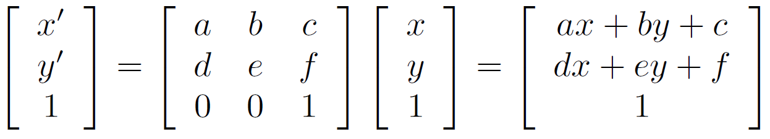
Affine transformations
How many unknowns?
How many equations per match?
How many matches do we need?

Slide 52
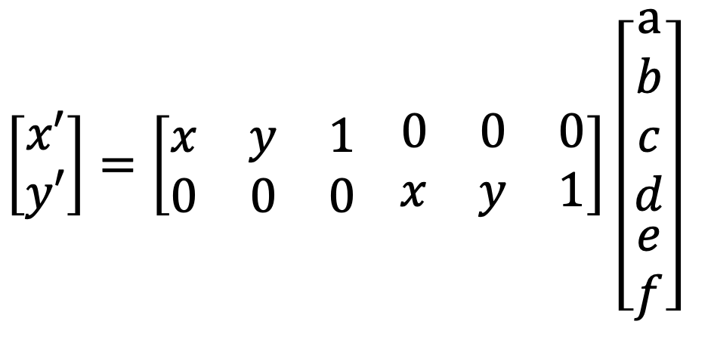
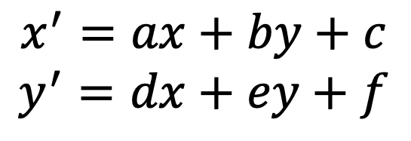
Affine transformations
For each match, we have
Matrix form
$$x^{′}=ax+by+c$$
$$y^{′}=dx+ey+f$$
$\left[\begin{matrix}x′ \\ y′\end{matrix}\right]=\left[\begin{matrix}x & y & 1 \\ 0 & 0 & 0\end{matrix} \begin{matrix}0 & 0 & 0 \\ x & y & 1\end{matrix}\right]$ $\left[\begin{matrix}\begin{aligned}a \\ b \\ c \\ d\end{aligned} \\ e \\ f\end{matrix}\right]$

Slide 53
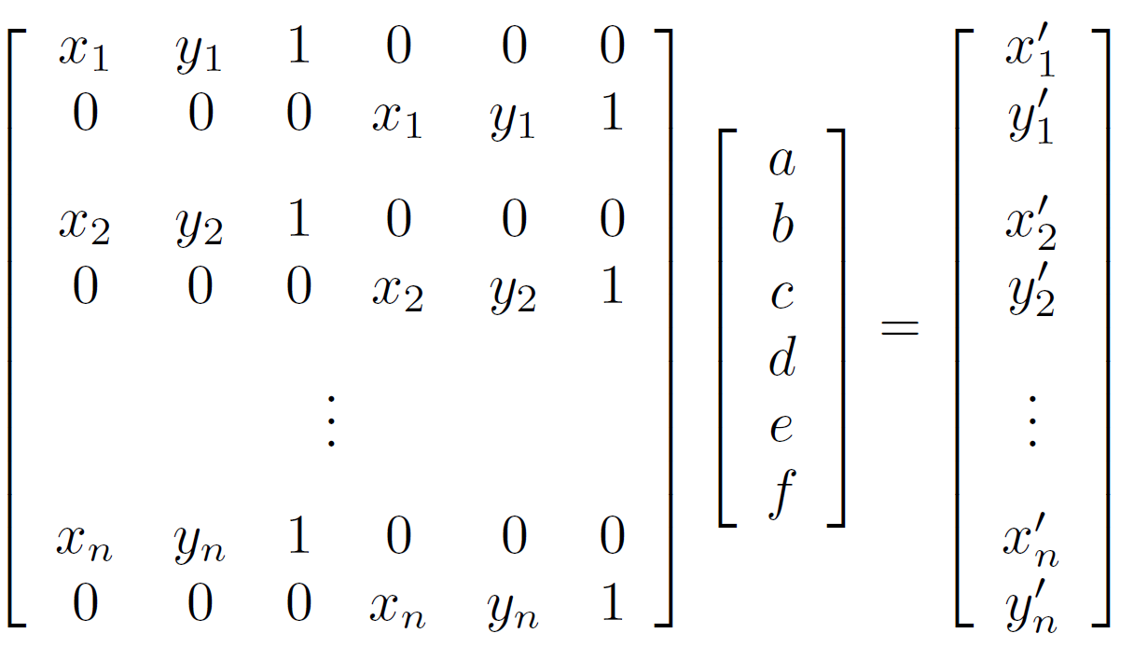




Affine transformations
For n matches
2n x 6
6 x 1
2n x 1

Slide 54

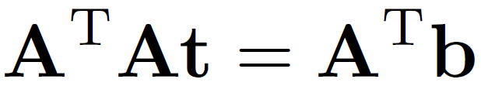
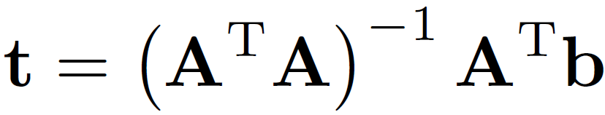
How to solve t?
Least squares: find t that minimizes
The solution is given by

Slide 55
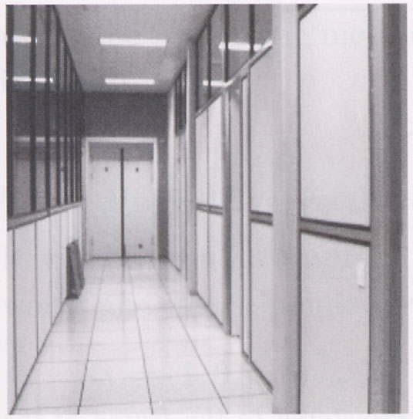
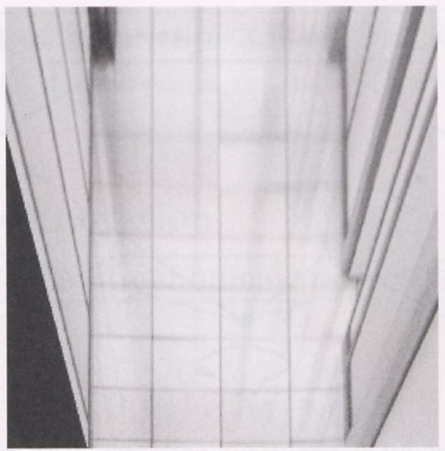
Projective transformations
p’
p
P’
Homography
P

Slide 56
Solving for homographies

Slide 57
Solving for homographies

Slide 58





Solving for homographies
2n × 9
9
2n
Defines a least squares problem:
  Constraint: $||h||=1$
  Solution: $\hat{h}$ = eigenvector of $A^{T}A$ with smallest eigenvalue
  Needs 4 or more points

Slide 59
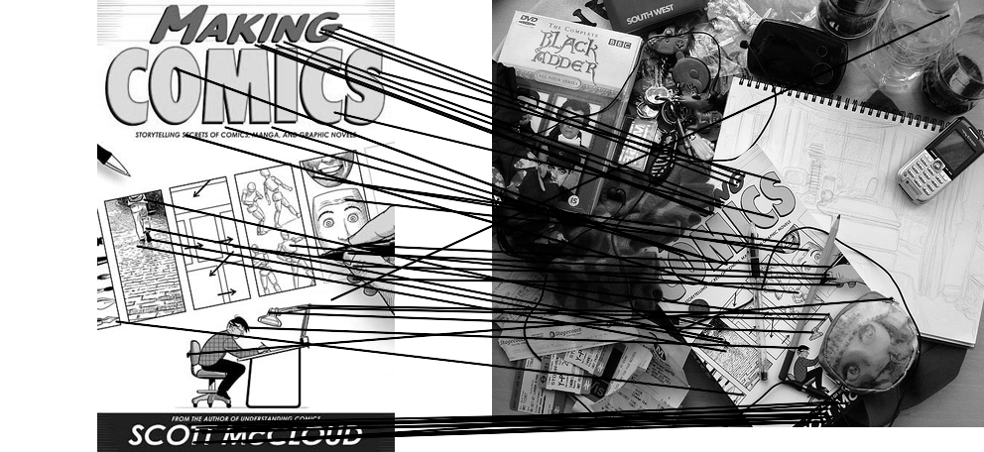
Outliers
outliers
inliers

Slide 60

Robustness
Let’s consider a simpler example… linear regression
How can we fix this?
Problem: Fit a line to these datapoints
Least squares fit

Slide 61
RANSAC

Slide 62
RANSAC
Inliers: 3

Slide 63
RANSAC
Inliers: 20

Slide 64
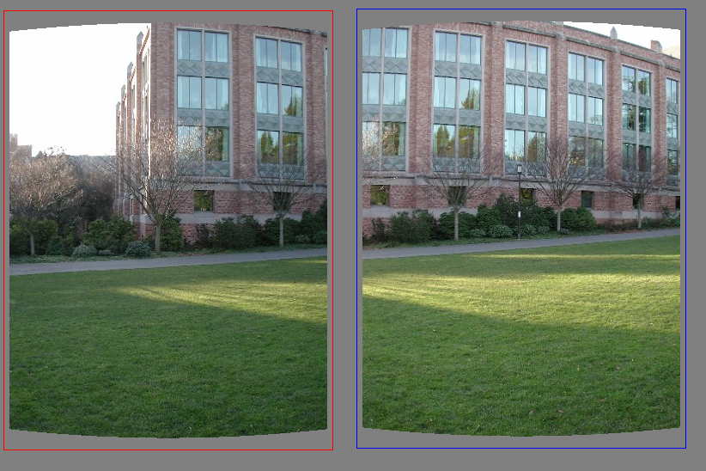
RANSAC for Translation

Slide 65
RANSAC for Translation
Select one match at random, count inliers

Slide 66
RANSAC for Translation
Select another match at random, count inliers

Slide 67
RANSAC for Translation
Output the translation with the highest number of inliers

Slide 68
Final step: least squares fit
Find average translation vector over all inliers

Slide 69
Image Stitching
Input images

Slide 70
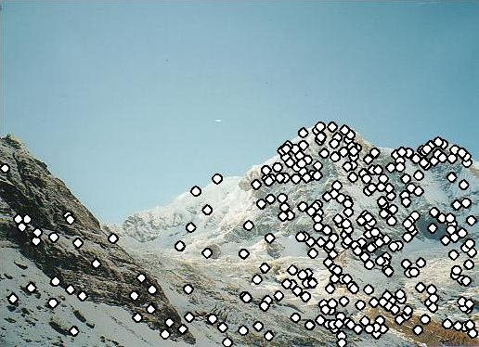
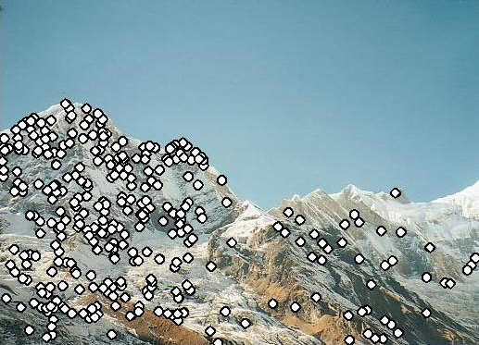
Image Stitching
Feature matching

Slide 71
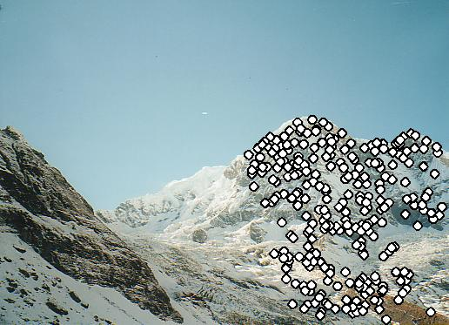
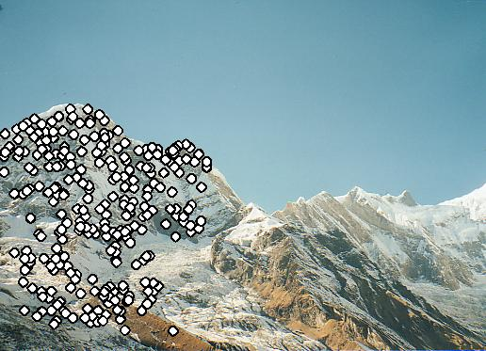
Image Stitching
Compute transformation matrix with RANSAC

Slide 72
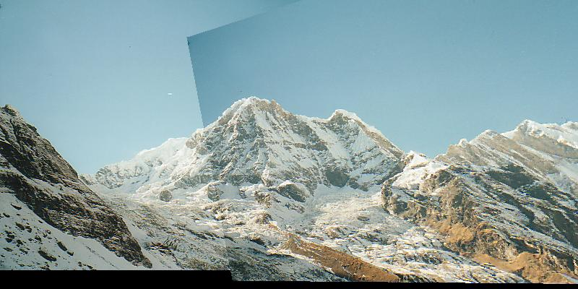
Image Stitching
Fix image 1 and warp image 2

Slide 73
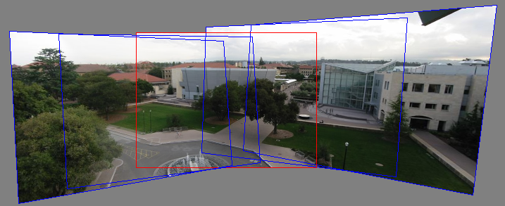
Panoramas
Now we know how to create panoramas!
1) Warp all images to a reference image; 2) merge them

Slide 74
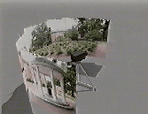

Rotation about vertical axis
What if our camera rotates on a tripod?
What’s the structure of H?
$$H=KRK^{−1}$$

Slide 75
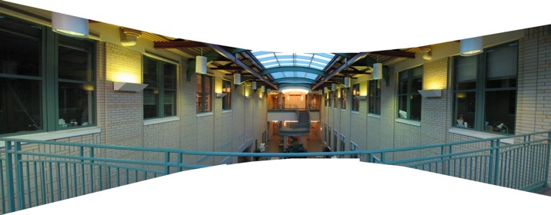
Do we have to project onto a plane?
mosaic PP

Slide 76
Full Panoramas
What if you want a 360° field of view?
mosaic Projection Cylinder

Slide 77



Cylindrical projection
$$y′$$
$$x′$$
unwrapped cylinder
unit cylinder
$(x^{′},y^{′})$ are cylindrical coordinates, $\left(x,y\right)$ are image coordinates (origin at image center), $r$ is the radius of cylinder, $f$ is the focal length

Slide 78




Cylindrical projection
y
$$y′$$
x
$$x′$$

Slide 79
Cylindrical panoramas
Steps
  Reproject each image onto a cylinder
  Blend
  Output the resulting mosaic

Slide 80
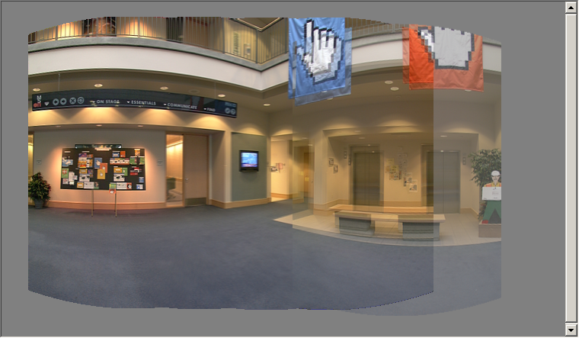
Cylindrical image stitching
What if you don’t know the camera rotation?
  Solve for the camera rotations
    A rotation of the camera is a translation of the cylinder!

Slide 81
Assembling the panorama
Stitch pairs together, blend, then crop

Slide 82
Problem: Drift
small (vertical) errors accumulate over time
apply correction so that sum = 0 (for 360° pan.)

Slide 83

Full-view (360°) panoramas

Slide 86
Questions?

